Slide 1

Panel on Recommended Nutrition competencies for Medical students and physician trainees
(JAMA Network Open, Sept. 30, 2024)
David Eisenberg, MD
Aviad (Adi) Haramati, PhD
Melinda Ring, MD
Amy Locke, MD
2025 International Conference on Integrative Medicine & Health
Seattle, WA
March 6, 2025
© DM Eisenberg, MD 2025
Notes:
1

Slide 2
Background, Rationale,
Methods, Primary Findings
and Implications
https://jamanetwork.com/journals/jamanetworkopen/fullarticle/2824217
David Eisenberg, MD
Director, Culinary Nutrition
Harvard T.H. Chan School of Public Health
2025 International Conference on Integrative Medicine & Health
March 6, 2025
© DM Eisenberg, MD 2025
Notes:
2

Slide 3
Will doctors ever be required to
learn about nutrition
and be able to advise patients about FOOD?
© DM Eisenberg, MD 2025
Notes:
3

Slide 4
Maybe sooner than you imagined!
© DM Eisenberg, MD 2025
Notes:
4

Slide 5
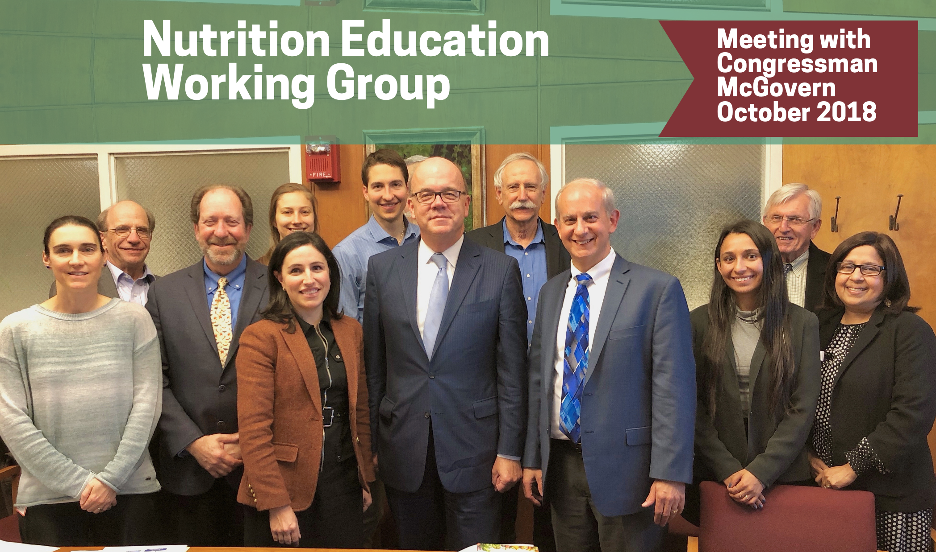
© DM Eisenberg, MD 2025
© DM Eisenberg, MD 2025
Notes:
5

Slide 6
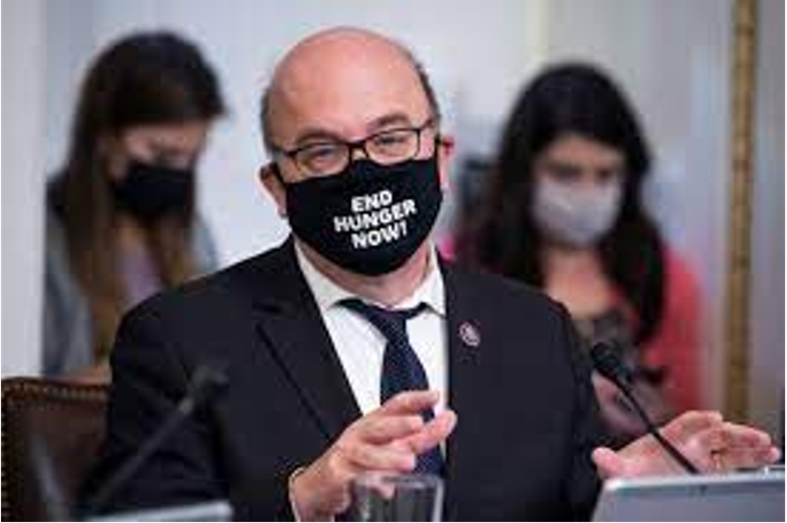
US House of Representatives Resolution 1118
J. McGovern (D-MA), M. Burgess (R-TX)
Passed May 17,2022
Bipartisan resolution calling for enhanced nutrition education for all medical students and physicians.
Challenge to Organized Medicine:
Demonstrate competencies advising patients about FOOD and NUTRITION or risk losing $10.3 B* in federal funding for training residents and fellows in US Hospitals.
*$16B in 2023
Notes:
Verify $ amount

Slide 7

Nutrition Education Summit (ACGME, AAMC, AACOM)
March 2023
Teaching medical students, doctors and patients to make better food choices in the absence of experiential learning about food-in kitchens
is like teaching kids and adults about the benefits of swimming in the absence of swimming pools.

Slide 8
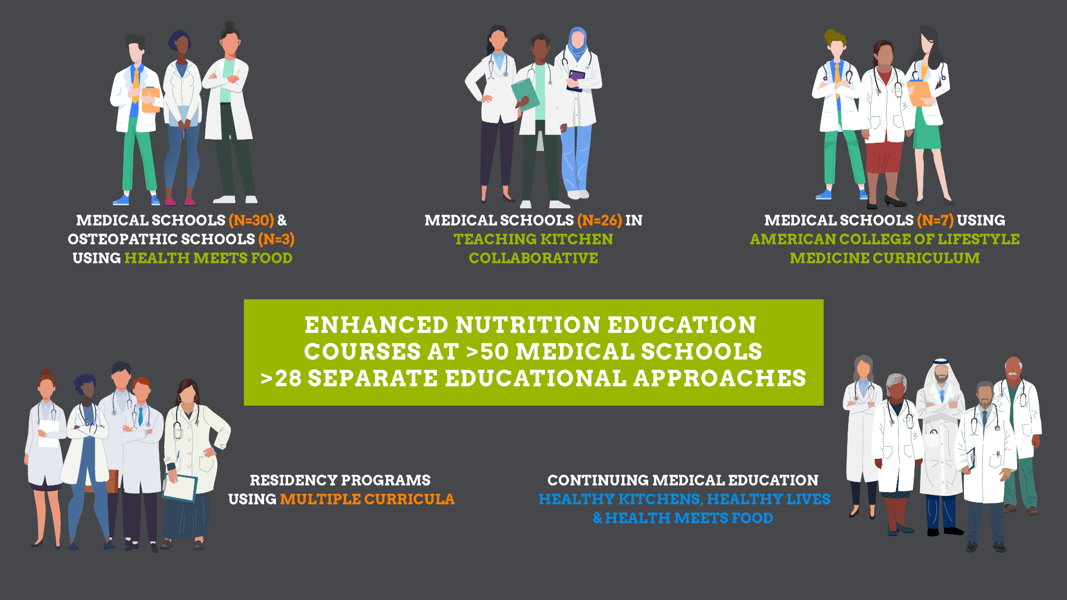

© DM Eisenberg, MD 2025

Slide 9
Nutrition Education Summit Proposition
Summit hosts (ACGME, AAMC, AACOM) were invited to assist with the development of a consensus on core competencies in nutrition for medical professionals
Notes:
Summary slide

Slide 10
Modified Delphi Process in Partnership with ACGME
Invitation
Rapid Literature Review
Modified Delphi Process
Analysis & Manuscript Preparation
37 subject matter experts across the US invited to participate
22 Nutrition Experts
15 Residency Directors (10 Specialties)
354 competencies identified
Refined to 78
based on quality and relevance
4 rounds of modified Delphi process to prioritize most essential competencies (n=36)
Experts also asked HOW these competencies should be evaluated
Manuscript written in collaboration with 37 subject matter experts, ACGME, Harvard Law School, and medical education advisors. Published by JAMA Network Open September 30, 2024
Notes:
Delphi technique: “framework of expert opinion rounds, with each round built on previous findings and each allowing for responses to be reconsidered by participants, is designed to allow the development of a consensus view that answers the research question” - https://ebn.bmj.com/content/23/3/68
The proposed competencies were refined to remove those that were too vague, too detailed, or not of sufficient quality or relevance.

Slide 11
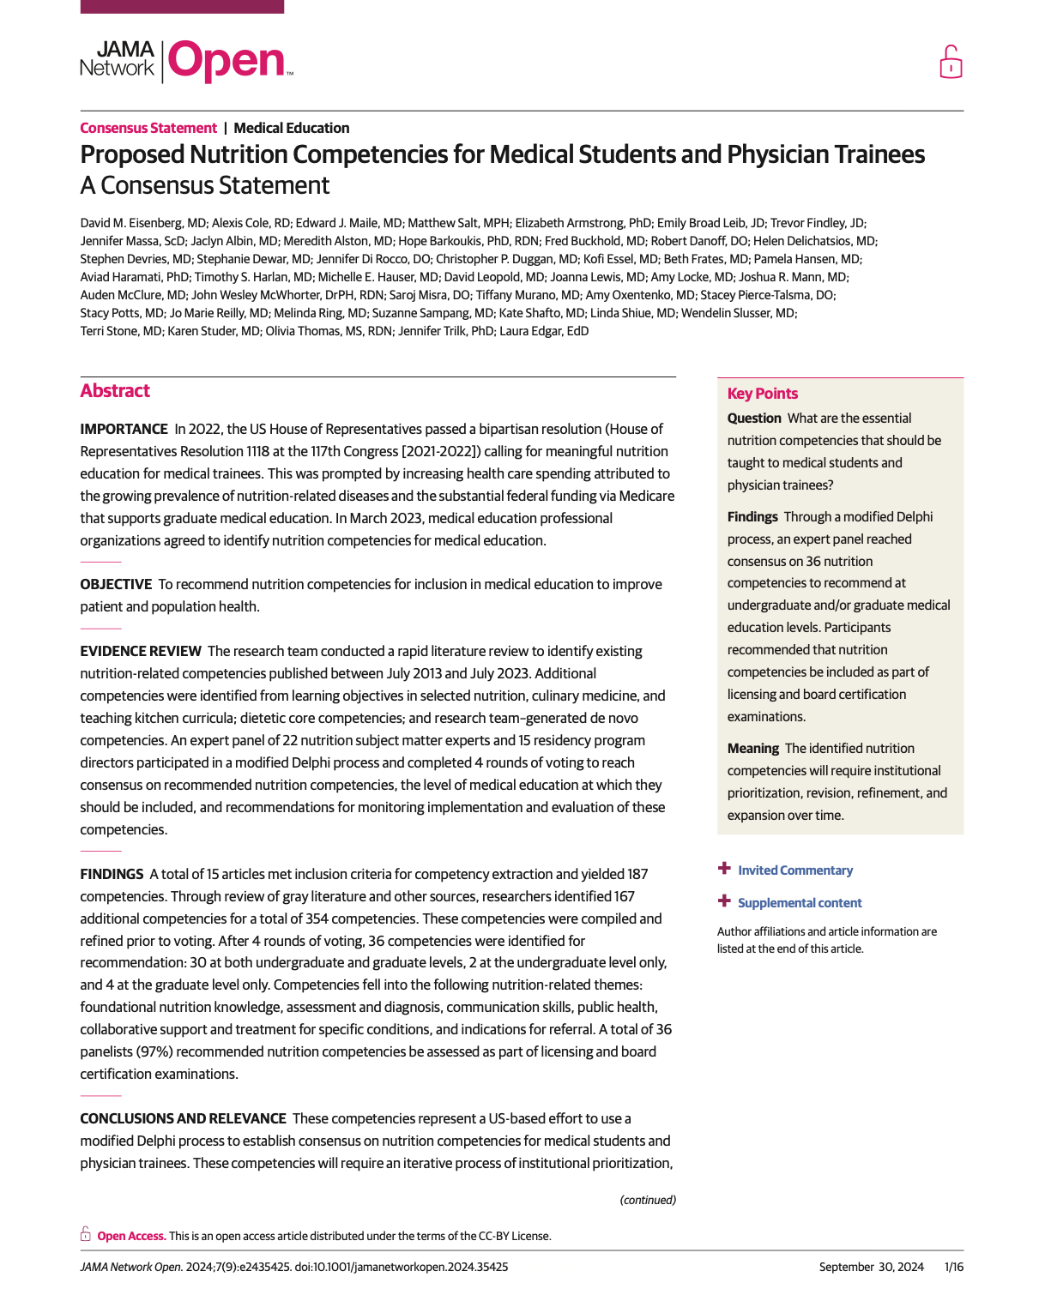
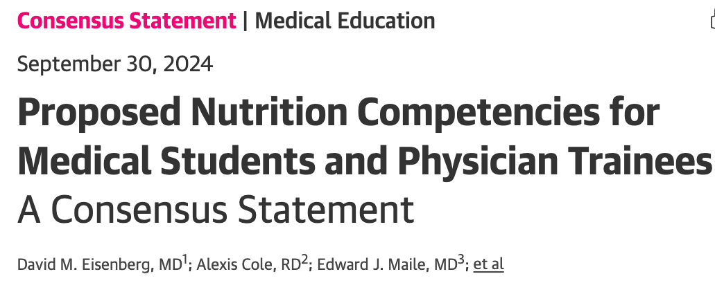

https://jamanetwork.com/journals/jamanetworkopen/fullarticle/2824217
Viewed >21,000 times since September 30, 2024

Slide 12
Themes & Selected Examples of Competencies
Foundational nutrition knowledge
Nutrition-related assessment and diagnosis
Nutrition-related communication skills
“Demonstrates knowledge of the nutritional content of foods including the major dietary sources of macronutrients and micronutrients”
“Assesses the nutritional status of a patient with a brief diet and food history/questionnaire, anthropometric measurements, and appropriate laboratory tests”
“Listens carefully, compassionately, and non-judgmentally while taking a nutrition history”

Slide 13
Identified Themes & Selected Example Competencies
Public health nutrition
“Demonstrates knowledge of public health nutrition, including the social determinants of health, and how it can reduce the burden of disease and improve access to adequate, healthy food”
Collaborative support and treatment for nutrition-related conditions
“Screens for food insecurity and nutrition insecurity and makes appropriate referrals
Indications for referrals
“Makes appropriate referrals to a range of professionals to support the patient to achieve their health goals”

Slide 14
Don’t you think the public believes
MDs already know how to do these things?
© DM Eisenberg, MD 2025

Slide 15

The Scream 1895/Edvard Munch

Slide 16
Additional Highlights
97% of panelists called for formal nutrition testing on licensing and certification exams in addition to Observational Specialized Clinical Exams (OSCE’s) and simulated patient exercises.
73% of panelists recommended a competency related to the environmental and planetary health impact of food choices for inclusion.

Slide 17
Examples of Identified Gaps
Whether, when, and how to recommend anti-obesity medications, including glucagon-like peptide 1 (GLP-1) agonists, in combination with diet and lifestyle guidance
How to responsibly use internet searches and Artificial Intelligence to access evidence based, practical advice about nutrition and food choices – and the many challenges therein

Slide 18
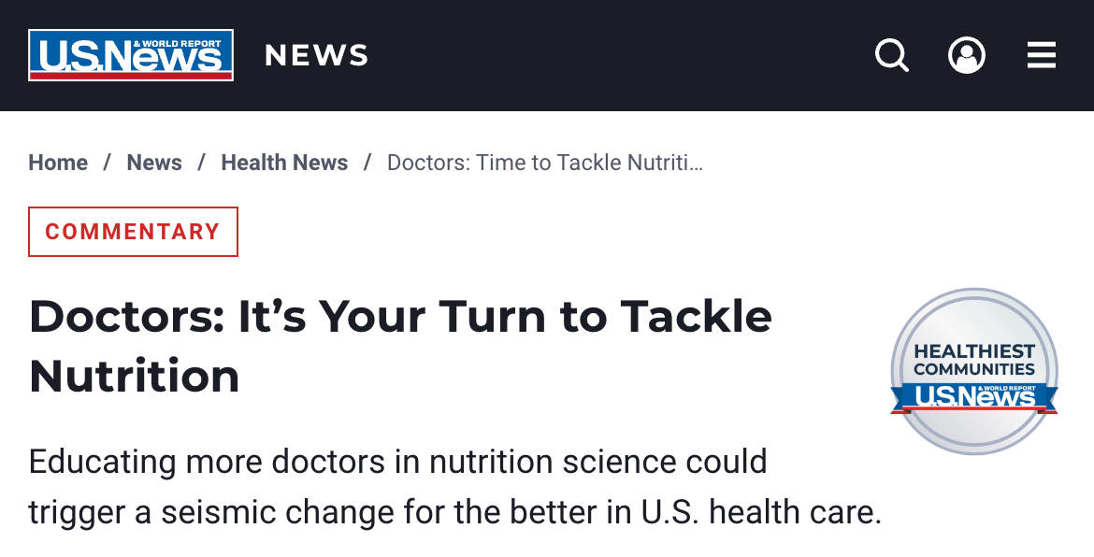

US News & World Report Op Ed: Oct. 30, 2024*
https://www.usnews.com/news/health-news/articles/2024-10-30/doctors-its-your-turn-to-tackle-nutrition
Co-authors: Rep. Jim McGovern, Emily Broad Leib, David Eisenberg
*usnews.com receives >42 million monthly views

Slide 19
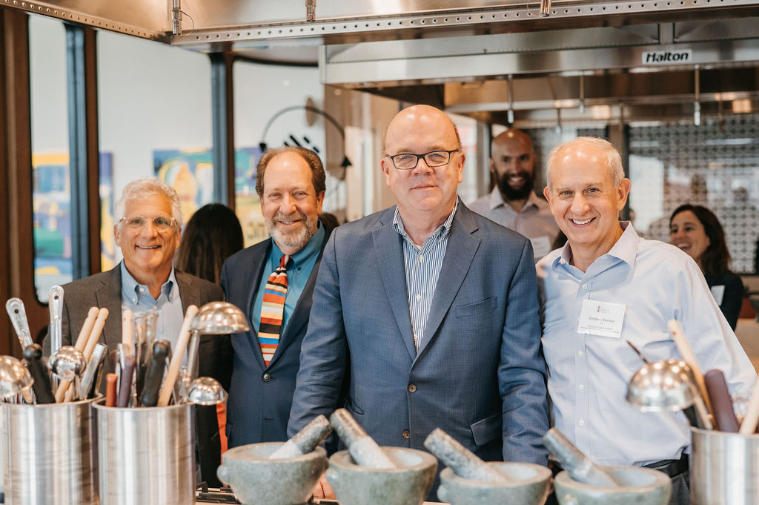
© DM Eisenberg, MD 2025

Slide 20
Op Ed Highlights
“Imagine a world where physicians, working with registered dietitians and other experts, routinely counsel patients on food choices and suggest menu options and recipes that are healthy, delicious, affordable and easy to prepare.”
“Imagine a world where food is embraced as a key part of disease prevention and health promotion, and where more medical schools and hospitals incorporate teaching kitchens* as experiential learning laboratories where trainees, staff and patients can learn to help others – and themselves – make healthier food choices.”
*link to TKC website

Slide 21
Implications Regarding Teaching Kitchens
Having published a Consensus on Nutrition Competencies in JAMA Network Open
When physicians are ultimately required to demonstrate competencies in advising patients about food choices,
Teaching Kitchens will likely become essential
Learning, Training, and Research Laboratories

Slide 22
Implications and Next Steps
Developing “Best Practices” is the logical next step.
These need to be shared, summarized and disseminated.

Slide 23
Examples of Competency Topics
Requiring Best Practices
Foundational Nutritional Knowledge:
What to eat & drink more of, less of, and why (which proteins, carbs, fats…)
Current Nutrition Controversies (Eggs, Organic, UPF’s)
Prescribing GLP-1 Meds in Combination with Diet and Exercise
Health Effects of Alcohol (and popular dietary supplements)
Optimizing Our Microbiomes
What to know about fad diets and how to talk with patients about them

Slide 24
Examples of Competency Topics
Requiring Best Practices
Nutrition Assessment and Diagnosis
Biometric and Anthropometric Measurements
to assess Nutritional Status
Screening for Food and Nutritional Insecurity
Relevant Social Determinants of Health for individual patients
How to perform these assessments effectively and non-judgmentally

Slide 25
Examples of Competency Topics
Requiring Best Practices
Communication Skills
How to take a better Food History?
How to discuss food / diet / weight with cultural sensitivity, empathy-and without being judgmental?
How to apply motivational interviewing and coaching skills?
How to meet patients where they are to establish trust.

Slide 26
Examples of Competency Topics
Requiring Best Practices
Public Health Nutrition
Social determinants of health (Again!)
How food environments impact behaviors and outcomes
How core principles of a healthy dietary pattern can be applied to all cultures and cuisines
How to access healthier food options; and, how to shop for these (reading labels, reading menus, accessing local/seasonal foods….)
How a “Planetary Diet” can be pursued (and enjoyed!) by all

Slide 27
Examples of Competency Topics
Requiring Best Practices
Collaborative, Transprofessional Referral and Treatment
Referrals to relevant subject matter experts (RDN’s, MD’s, chefs, exercise experts, mindfulness instructors, health coaches, local farmers, and others)
How Teaching Kitchens are increasingly being used as learning laboratories, train the trainer sites, and research hubs
Referrals to local resources

Slide 28
Examples of Competency Topics
Requiring Best Practices
Understanding that how YOU eat is a strong predictor of how you will advise your patients
(and family memebrs) to eat.

Slide 29
Extraordinary Momentum of Food Is Medicine
2022-2025
© DM Eisenberg, MD 2025
Notes:
29

Slide 30
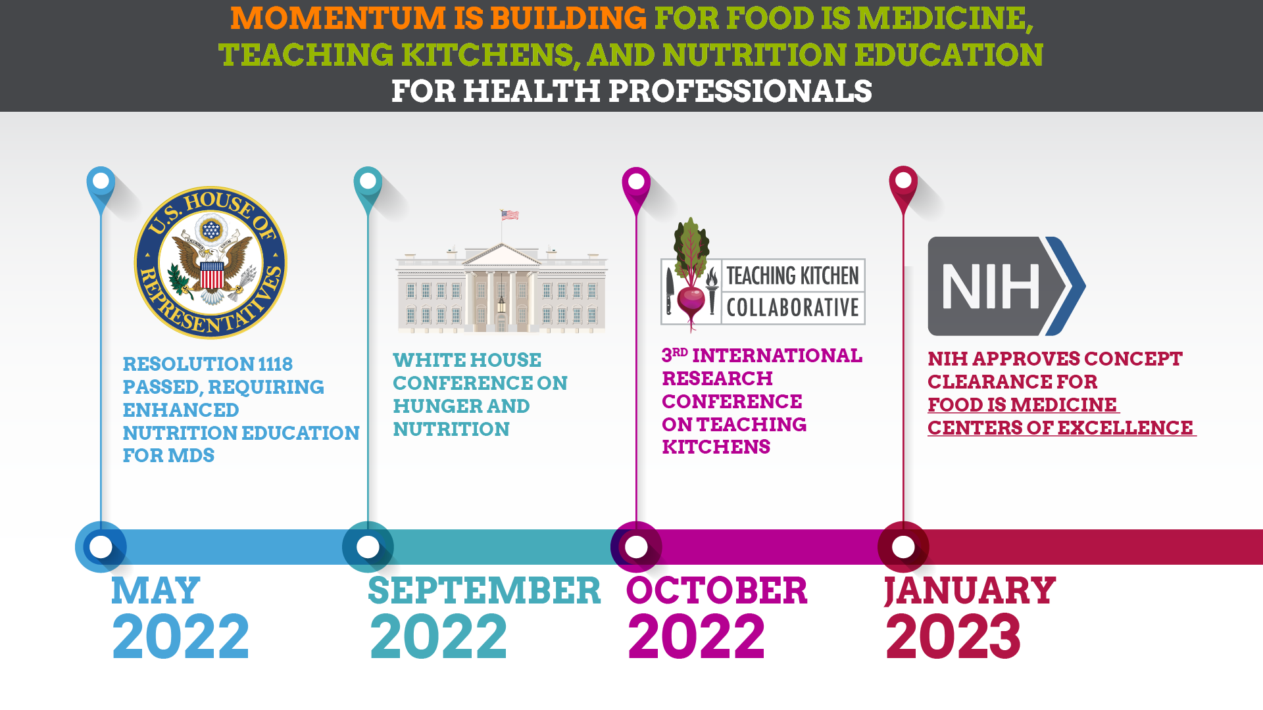
© DM Eisenberg, MD 2025

Slide 31
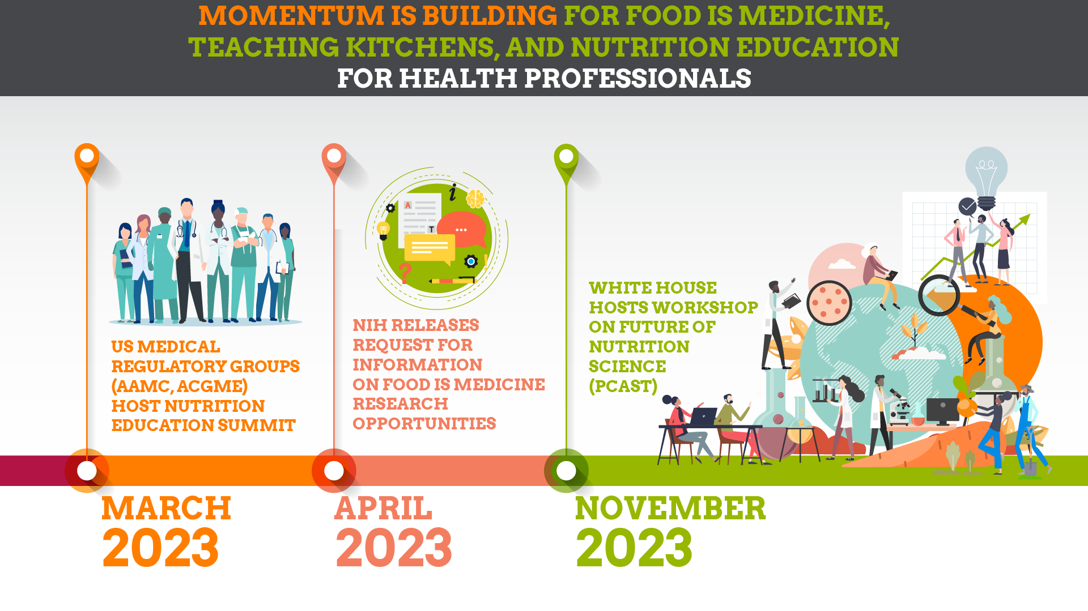
© DM Eisenberg, MD 2025

Slide 32
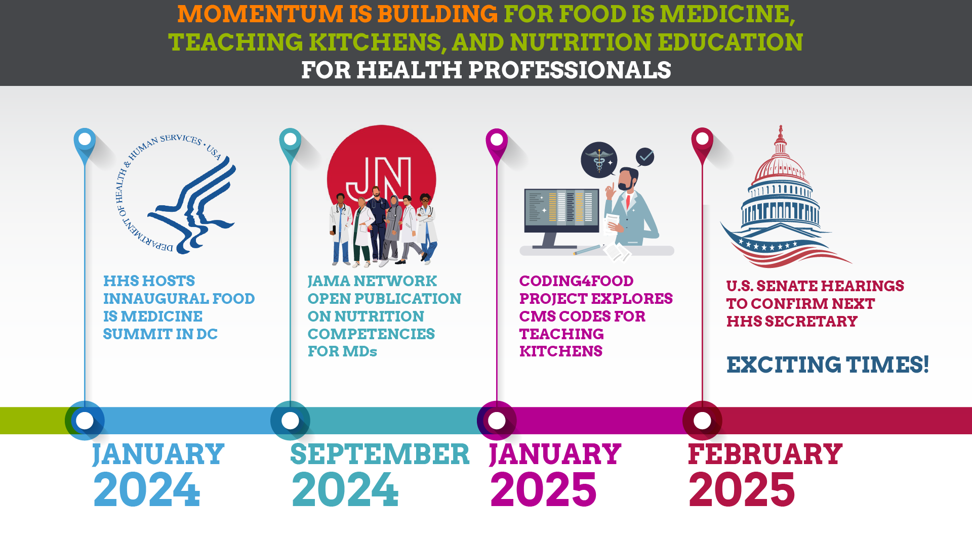
© DM Eisenberg, MD 2025

Slide 33
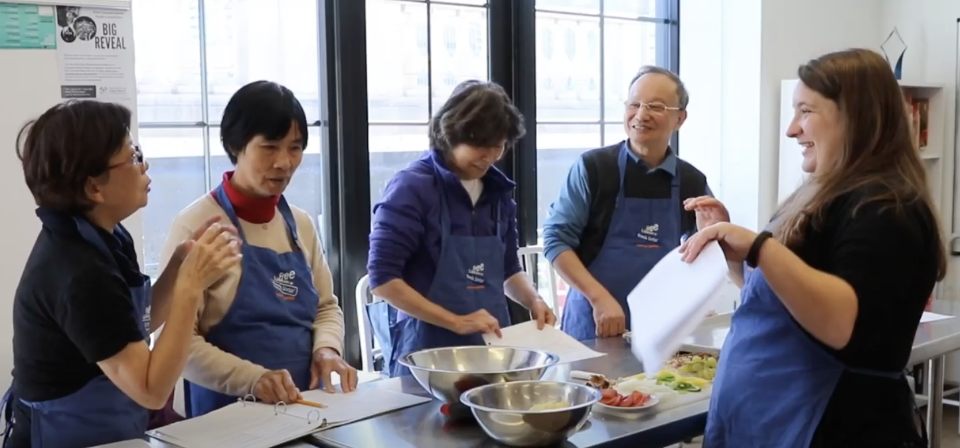
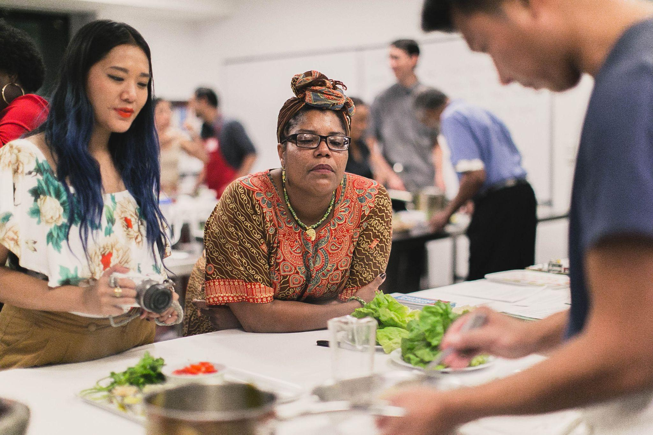
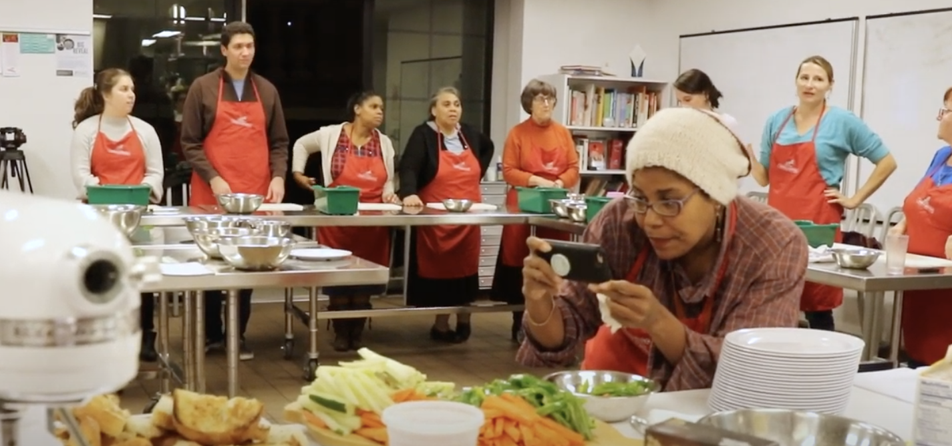
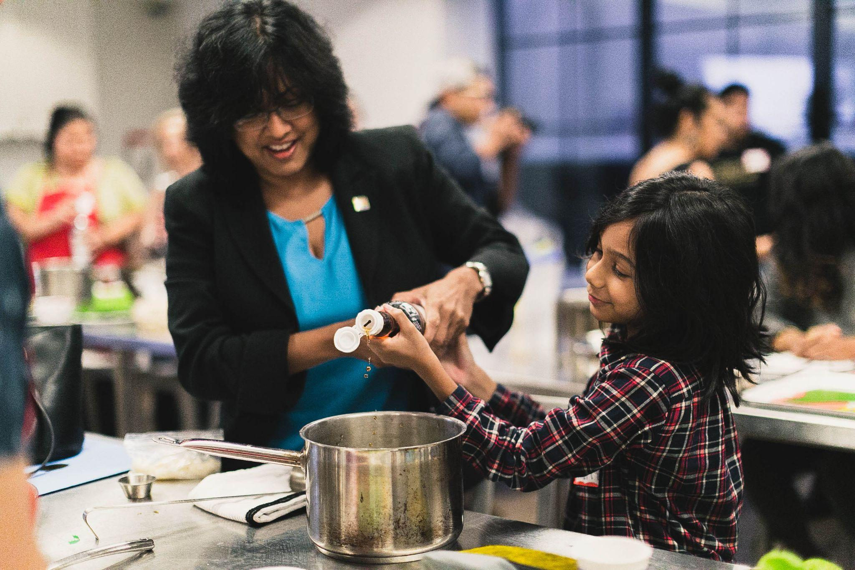
Nutrition Competencies
Are In Our Immediate Future
Notes:
Notes:
Remind audience that TK’s are the place where the what, why & how to change is shared over great food
Imagine a global network of teaching kitchens for research, education & public and planetary health
Sources:
Materials shared by Liz Fitzgerald via email (5/11/20)

Slide 34

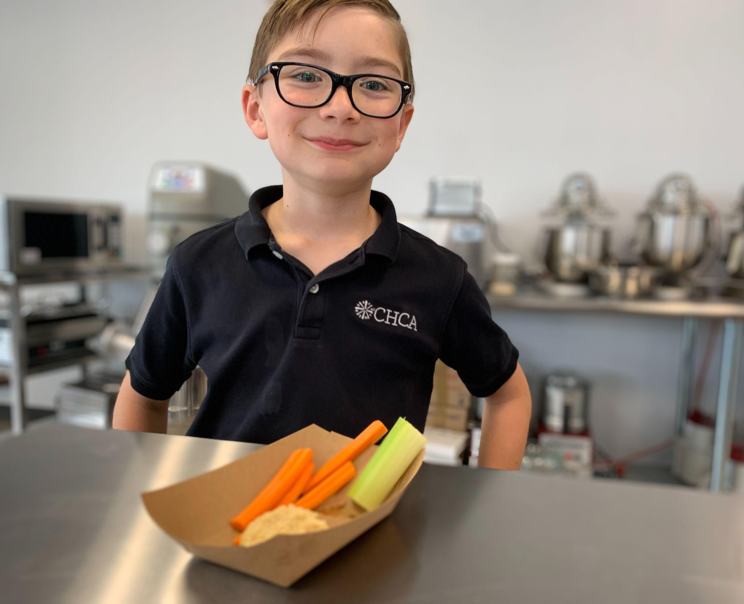
Thank You!
Photo Courtesy of Stephen Carter,
Cincinnati Hills Christian Academy
David Eisenberg
DEISENBE@HSPH.HARVARD.EDU
© DM Eisenberg, MD 2025

Slide 35
Competencies in Nutrition:
Implications and Challenges for Medical Education
Aviad Haramati, PhD
Professor of Integrative Physiology and Medicine
Director, Center for Innovation and Leadership in Education (CENTILE)
Georgetown University Medical Center,
Washington, DC, USA

Slide 36

The Association of American Medical Colleges (AAMC), the American Association of Colleges of Osteopathic Medicine (AACOM), and the Accreditation Council for Graduate Medical Education (ACGME) have co-sponsored an initiative to create a common set of foundational competencies for use in undergraduate medical education programs in the United States.
Final Draft issued December 2024

Slide 37
Foundational Competencies in Undergraduate Medical Education (49)
PATIENT CARE: Demonstrates compassionate, effective, evidence-informed, and equitable patient-centered care.
MEDICAL KNOWLEDGE: Applies and integrates foundational, clinical, and social sciences knowledge to improve health care for patients and populations.
SYSTEMS-BASED PRACTICE: Applies knowledge of the larger context of health, including its social and structural determinants, and of systems and resources within and outside of health care to optimize patient, community, and population health.
PRACTICE-BASED LEARNING AND IMPROVEMENT: Integrates feedback, evidence, and reflection to adapt behavior, foster improvement, and cultivate lifelong learning.
PROFESSIONALISM: Demonstrates integrity, respect, and ethical reasoning and promotes inclusion in all interactions to improve health care for patients, communities, and populations
INTERPERSONAL AND COMMUNICATION SKILLS: Effectively communicates and interacts with patients, caregivers, and the health care team to contribute to high-quality patient-centered care.

Slide 38
Top 10 Suggested Nutrition Competencies
No | Type | Competency
1 | Nutrition Counseling | Provides evidence-based, culturally sensitive nutrition and food recommendations to patients for prevention and treatment of disease
2 | Nutrition Counseling | Screens for food insecurity and nutrition insecurity and make appropriate referrals to those at risk
3 | Approach to patient | Works with other health professionals to deliver a multidisciplinary approach to nutrition care
4 | Knowledge Application | Identifies pathophysiologic and /or socioeconomic circumstances which may lead to metabolic syndrome or malnutrition
5 | Knowledge Application | Assesses the nutritional status of a patient with a brief diet or food history or questionnaire, anthropometric measurements, and appropriate laboratory tests
6 | Approach to patient | Starts a sensitive, nonjudgmental conversation about food and lifestyle in a brief consultation within a primary or secondary care setting
7 | Knowledge | Demonstrates knowledge of the nutritional content of foods including the major dietary sources of macronutrients and micronutrients
8 | Knowledge Application | Integrates evidence-based nutrition information from national nutrition guidelines, scientific publications, and other sources into patient care
9 | Knowledge | Demonstrates knowledge of public health nutrition, including social determinants of health, and how it can reduce the burden of disease and improve access to adequate, healthy food
10 | Approach to patient | Demonstrates sensitivity to the social, cultural, emotional, economic, educational, and psychological factors that may affect an individual’s nutrition behavior, food choices and health status

Slide 39
Nutrition Competencies in the Medical Curriculum: Challenges
The curriculum is already overloaded
Competencies require more than knowledge acquisition
  knowledge application, counseling skills, attitudinal aspects
How to incorporate into clinical rotations/clerkships
Assessment necessitates faculty observation
Is a teaching kitchen helpful? Use of virtual sessions?

Slide 40
Nutrition Competencies in the Medical Curriculum: Opportunities
Integrating material with other subjects
  (e.g. cardiovascular, renal, endo; social determinants of health)
Experiential learning in pre-clinical curriculum
  (e.g. glucose monitoring in metabolism, mindful eating)
Nutrition competencies suited for a curricular thread
  Knowledge application, counseling skills, attitudinal aspects
Creative clinical skills training and assessment
  Revising cases, OSCE designs, longitudinal clerkships
Interprofessional education with other professionals

Slide 41
Nutrition Competencies in the Medical Curriculum: Opportunities
Students taking the lead as champions
  Some medical students are trained chefs, or enjoy cooking
Faculty as role models
  (sharing their personal journeys, demos for culinary medicine)
Engagement with local chefs
  (opportunities for both chefs and students/faculty to partner)

Slide 42
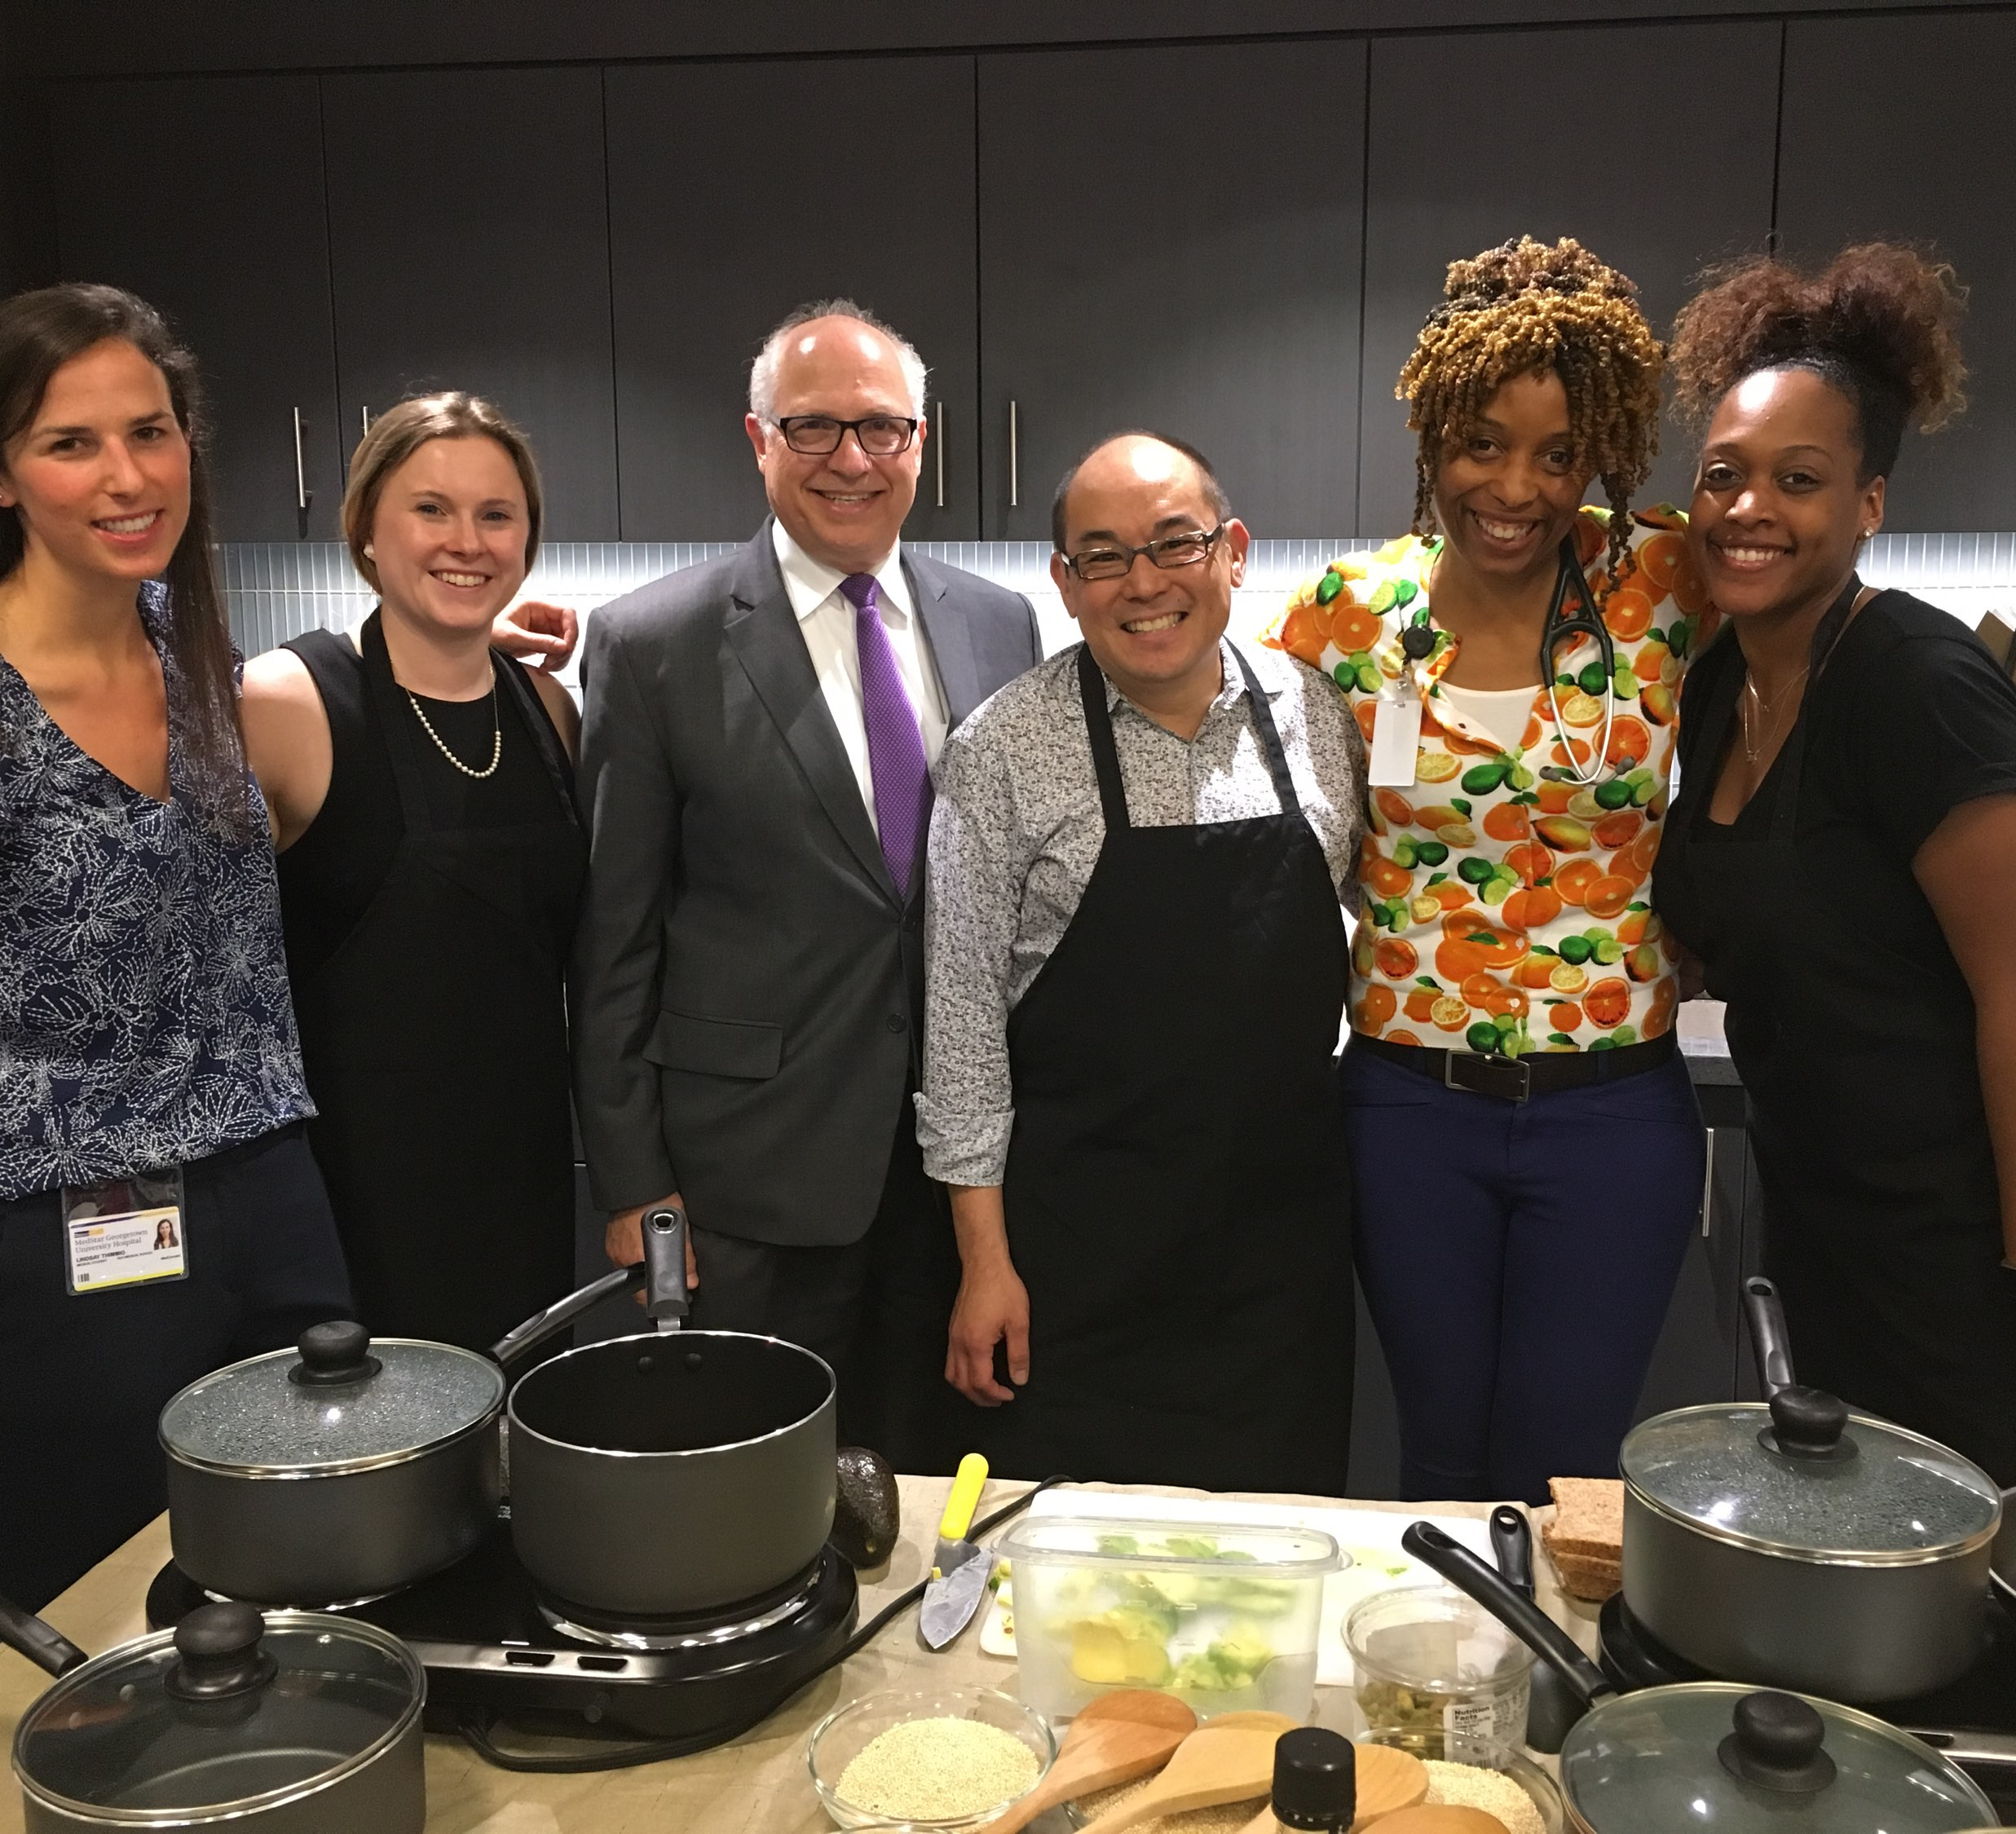
Fresh & Savory
Culinary and Lifestyle Medicine Pop up Teaching Kitchen
Shared Medical Appt

Slide 43
Nutrition Competencies in the Medical Curriculum
  Yes, there are challenges,
  but there are also wonderful opportunities to advance medical education!

Slide 44
Suggested Nutrition Competencies (UME)
No | Type | Competency
35 | Knowledge | Demonstrates knowledge of the functions of essential nutrients
7 | Knowledge | Demonstrates knowledge of the nutritional content of foods including the major dietary sources of macronutrients and micronutrients
36 | Knowledge | Demonstrates knowledge of the principles of a healthy balanced diet (in line with national guidelines)
9 | Knowledge | Demonstrates knowledge of public health nutrition, including social determinants of health, and how it can reduce the burden of disease and improve access to adequate, healthy food
11 | Knowledge | Demonstrates knowledge of the pathophysiological states that can affect the absorption of macronutrients, micronutrients, and other food based compounds
20 | Knowledge | Demonstrates knowledge of the difference between food allergies and food intolerance
24 | Knowledge | Demonstrates knowledge of how energy and nutrient requirements in health and disease differ across the lifespan
25 | Knowledge | Demonstrates knowledge of possible drug-nutrient interactions between certain foods, beverages, and medications
26 | Knowledge | Demonstrates knowledge of nutritional differences between unprocessed, minimally processed and ultraprocessed foods
29 | Knowledge | Demonstrates knowledge of the environmental impact of food production and how food choices can promote or diminish both personal and planetary health

Slide 45
Suggested Nutrition Competencies
No | Type | Competency
4 | Knowledge Application | Identifies pathophysiologic and /or socioeconomic circumstances which may lead to metabolic syndrome or malnutrition
5 | Knowledge Application | Assesses the nutritional status of a patient with a brief diet or food history or questionnaire, anthropometric measurements, and appropriate laboratory tests
8 | Knowledge Application | Integrates evidence-based nutrition information from national nutrition guidelines, scientific publications, and other sources into patient care
12 | Knowledge Application | Identifies nutrient deficiencies and recommends foods and/or supplements as needed
14 | Knowledge Application | Assesses diet and food intake and performs a comprehensive nutrition-focused physical examination to identify factors affecting a patient’s health status
27 | Knowledge Application | Interprets information on nutrition facts panels, nutrition labels, and menus to make appropriate recommendations to support patients’ individual needs and food choices
30 | Knowledge Application | Demonstrates knowledge of how to create a culinary nutrition SMART goals for personal use and for patient care

Slide 46
Suggested Nutrition Competencies
No | Type | Competency
1 | Nutrition Counseling | Provides evidence-based, culturally sensitive nutrition and food recommendations to patients for prevention and treatment of disease
2 | Nutrition Counseling | Screens for food insecurity and nutrition insecurity and make appropriate referrals to those at risk
15 | Nutrition Counseling | Utilizes evidence-based models of behavior change to assess patients’ readiness in order to effectively counsel patients for how to modify their diet and food choices to improve health
16 | Nutrition Counseling | Guides patients with regard to food choices in establishing lifelong dietary patterns to promote healthy weight and prevent or address chronic disease
17 | Nutrition Counseling | Identifies community-based nutrition resources for patients experiencing food and nutrition insecurity
21 | Nutrition Counseling | Interprets physical examination data and biomarkers against reference ranges to identify patients at risk of malnutrition
23 | Nutrition Counseling | Provides brief counseling interventions to help patients decrease visceral adiposity or reduce risk of metabolic syndrome
28 | Nutrition Counseling | Identifies factors which affect their personal health and nutrition status

Slide 47
Suggested Nutrition Competencies
No | Type | Competency
3 | Approach to patient | Works with other health professionals to deliver a multidisciplinary approach to nutrition care
6 | Approach to patient | Starts a sensitive, nonjudgmental conversation about food and lifestyle in a brief consultation within a primary or secondary care setting
10 | Approach to patient | Demonstrates sensitivity to the social, cultural, emotional, economic, educational, and psychological factors that may affect an individual’s nutrition behavior, food choices and health status
13 | Approach to patient | Demonstrates empathy and sensitivity when counseling patients with obesity and eating disorders
18 | Approach to patient | Communicates diet, food and nutrition information to patients using their preferred language, via interpretive services if needed, based on education and health literacy levels
19 | Approach to patient | Listens carefully, compassionately and nonjudgmentally while taking a nutrition history
22 | Approach to patient | Demonstrates awareness of one’s own biases about food, food choices, obesity, and ‘healthy eating’

Slide 48
Current State of Nutrition Education at Northwestern University Feinberg School of Medicine: Opportunities and Challenges for Integrating New Nutrition Competencies
Melinda Ring, MD, FACP, ABOIM
Director, Osher Center for Integrative Health at NOrthwestern University
Notes:
Panel on Recommended Nutrition Competencies for Medical Students and Physician Trainees DRAFT Oct 16 AH-MR.docx

Slide 49
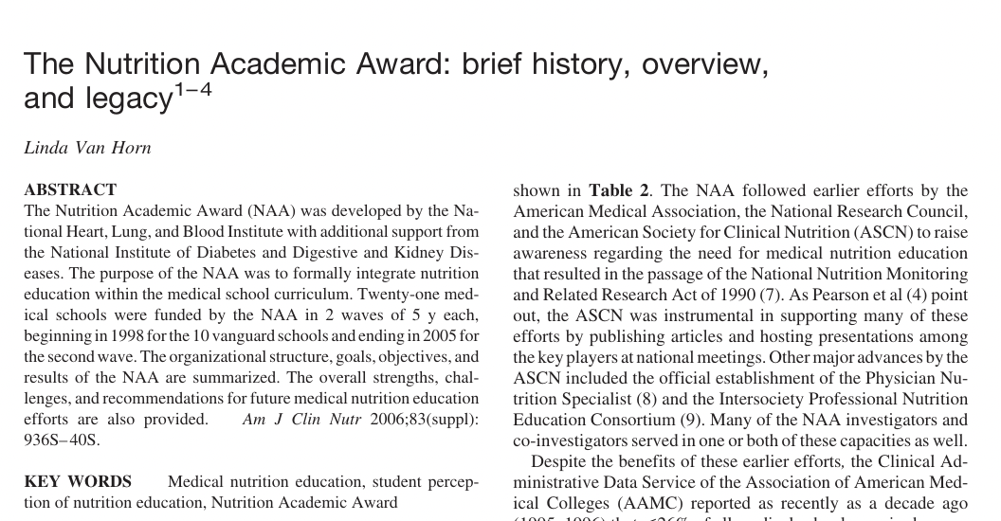

The Nutrition Academic Award (NAA) was developed by the National Heart, Lung, and Blood Institute with additional support from the National Institute of Diabetes and Digestive and Kidney Diseases. The purpose of the NAA was to formally integrate nutrition education within the medical school curriculum. Twenty-one medical schools were funded by the NAA in 2 waves of 5 y each, beginning in 1998 for the 10 vanguard schools and ending in 2005 for the second wave.
Van Horn L. The Nutrition Academic Award: brief history, overview, and legacy. Am J Clin Nutr. 2006 Apr;83(4):936S-940S.

Slide 50
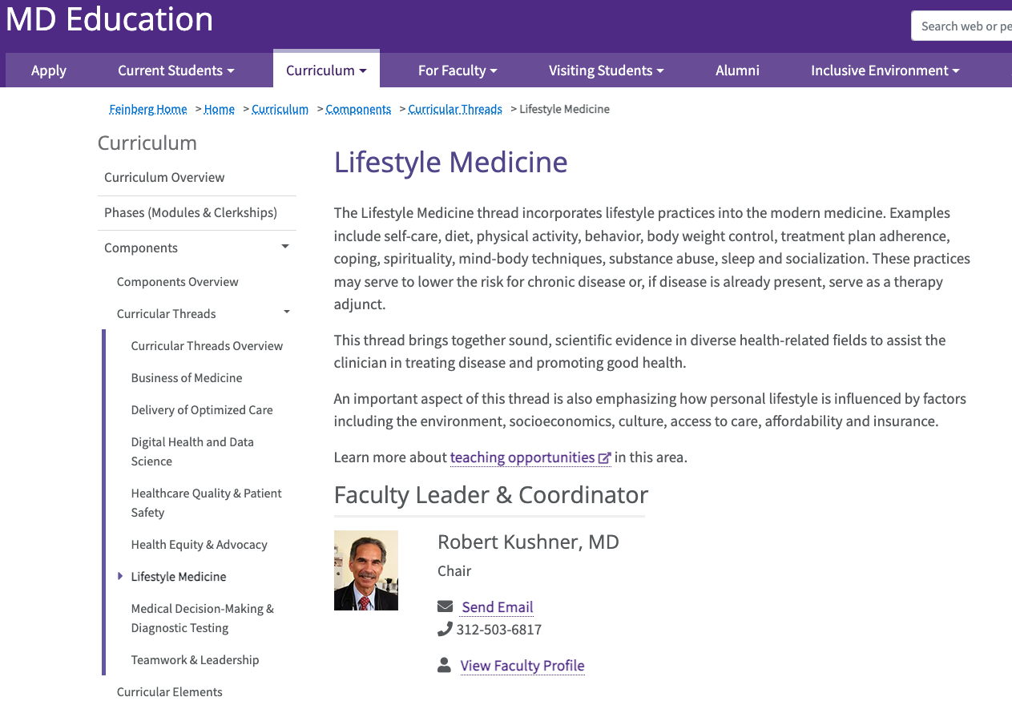
Notes:
The limited data available to date suggest that improving students’ own lifestyle habits helps to improve their nutrition counseling skills as well (20). By starting with themselves and examining their own lifestyle behaviors within the context of the current dietary guidelines and recommendations, medical students can acquire a useful introduction to this process that can help them be more sensitive and supportive when encountering future patients who likewise need to make these changes. The use of food diaries, and self-monitoring eating behaviors, regular weighing, and monitoring physical activity can familiarize students with the tools and techniques needed to promote ongoing adherence. At Northwestern University Feinberg School of Medicine, students complete a 10-wk Behavior Change Plan in which they self-select a health behavior to either increase (eg, exercise, fruit and vegetable intake, dental flossing) or decrease (eg, soda or fried food intake, fingernail biting), monitor baseline occurrence, set goals, and implement a change
Northwestern University Feinberg School of Medicine has incorporated a Lifestyle Medicine Thread that is sewn throughout the curriculum to highlight the importance of healthy lifestyle behaviors to enhance wellness, prevent disease, and manage chronic illness. During the first 2 y of instruction, each organ system block includes lifestyle topics and themes that are pertinent to the system. For example, during the cardiovascular block, the concept of cardiovascular health metrics and “Life’s Simple 7,” which combines 4 health behaviors (smoking, diet, physical activity, and body weight) with 3 health factors (plasma glucose, cholesterol, and blood pressure) to assess cardiovascular risk, is introduced (28). The use of a Lifestyle Medicine Thread allows educators to sequentially and purposely introduce new learning experiences that emphasize foundational lifestyle concepts.

Slide 51
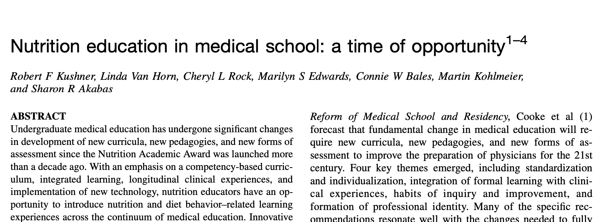
Kushner RF, Van Horn L, Rock CL, Edwards MS, Bales CW, Kohlmeier M, Akabas SR. Nutrition education in medical school: a time of opportunity. Am J Clin Nutr. 2014 May;99(5 Suppl):1167S-73S. doi: 10.3945/ajcn.113.073510.

Slide 52
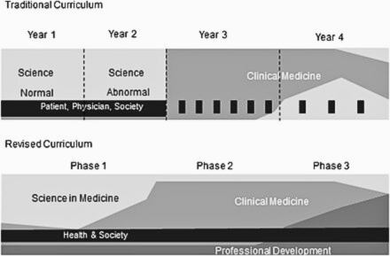
Notes:
FIGURE 1. Depiction of traditional and revised medical curriculum at Northwestern University Feinberg School of Medicine. In the traditional design, the first 2 y are primarily devoted to normal and abnormal scientific-related topics. The third and fourth years focus on clinical medicine.
The “Patient, Physician & Society” curriculum addresses a variety of topics including communication, ethics, humanities, health economics, and the practice of medicine. In the revised curriculum, the traditional 4 y are replaced with 3 competency-based phases and 4 element groups. Phase 1
includes the first 20 mo of instruction. Fourteen modules of varying lengths are organized by organ systems, with normal and abnormal functions covered in each. The modules contain all 4 elements of the new curriculum, with Science in Medicine predominating. The second phase includes intense clinical experiences through core clerkships that are department-based and span multiple disciplines. The final phase focuses on advanced clinical rotations as well as professional development in a niche focus in medicine, or Area of Scholarly Concentration, that the students research and select in the first year. Learners will immerse themselves in these specific themes in research, education, or community service (see http://www.feinberg.northwestern.edu/
education/curriculum/model/phases.html).
Nutrition-based learning objectives and resources can be appropriately included in the blocks of lectures in the first 2 y that are focused on gastroenterology, endocrinology, hematology/oncology, cardiovascular, pulmonary, and renal systems. Nutrition thus becomes a focused area or thread that runs through these blocks instead of an isolated course with a distinctly separate set of knowledge and skills. Although this approach poses a potential risk that students might not recognize nutrition as a distinct discipline, strategic steps can be taken to prevent this from occurring (11). It is beneficial to coordinate and link the nutrition sessions that have been integrated across the blocks through common resources (eg, Web-based material, textbooks, and unified search terms on the electronic blackboard) and monitoring of the learning objectives and content. Evaluation of nutrition knowledge and skills can be accomplished with specific questions included in the block examinations and/or with an annual separate thread examination.
Clinical foundations and skills are now typically introduced in the first year, with a focus on learning clinical examination and assessment skills in either simulated or actual assigned clinical settings. Nutrition-relevant history-taking and examination skills can be readily integrated into this component of the curriculum. Examples are as follows: taking a dietary, physical activity, and weight history; collecting anthropometric measures and calculating BMI; understanding and interpreting relevant laboratory measures; and conducting simple measures of cardiopulmonary fitness.
Nutrition can be readily integrated into problem-based learning modules (12). These modules are typically presented and discussed in small groups that are facilitated by a heterogeneous mix of faculty who do not have training in nutrition. Nutrition faculty need to provide the relevant objectives, content, background reading, and resources for the facilitators and students. In these modules, students work through a patient scenario, with independent assignments and intellectual exploration outside of the classroom, then report their findings back to the group for discussion.
Another hallmark of medical education reform at many medical schools is a longitudinal ambulatory care externship or apprenticeship, which involves medical students in clinical experience from the first year onward. Adoption of the patient-centered medical home as an “education-centered medical home” is another example of integration (13). These ambulatory care assignments enable medical students to interact with dietetics professionals who can reinforce clinical nutrition skills.
Required clerkships in the third year of medical school provide another venue for integrating nutrition education. Clerkships such as primary care, surgery, pediatrics, psychiatry, and obstetrics/gynecology are particularly appropriate for inclusion of nutrition objectives, content, and skills. Providing content and resources to clerkship directors, as well as monitoring seminar topics, can ensure the continuation of nutrition education. Incorporating nutrition education into the fourth-year elective clerkships can be more challenging, and there is less capability of standardizing across the entire student population. However, depending on the clerkship director, further reinforcement of nutrition knowledge and skills is possible during specialty rotations, such as obesity training during endocrinology, malabsorption during gastroenterology, and specialized nutritional support during surgery. In addition, fourth-year electives provide an opportunity for deeper learning for those students interested in diet and nutrition science.
Finally, many medical schools have a community-based, student-run free clinic that provides basic medical services to the underserved and other persons with access and affordability issues. Identifying faculty advisors and volunteers along with providing necessary resources can help to integrate nutrition practice skills into that venue.

Slide 53
FSM Nutrition Education
Required
Embed nutrition within the existing curriculum including Lifestyle medicine thread
Emphasize the prevention/treatment aspects within chronic and infectious diseases.
Electives/Seminars
Osher provides courses in culinary medicine for M1 and M3/4 students - but this reaches 30 med students/year on average
Sporadic
Student-led nutrition clubs, journal clubs

Slide 54
Challenges Ahead
Takeaways from discussion with deans of curriculum:
Ultimately, the Boards are what prioritize the content of the curriculum at most medical schools. FSM curriculum is highly geared towards achieving excellence on the Board Exams and has been highly successful in that regard.
Leadership believes it is critical to teach nutrition because it is important to be a good clinician-- but with limited instructional time, we have to ensure that we are also focusing on what they will be assessed on.
Despite best efforts at the national level to increase them, Board exams limit nutrition related questions to no more than 1-2 objective questions, at most.
NBME/USMLE are behind in advancing content to match what’s currently taught

Slide 55
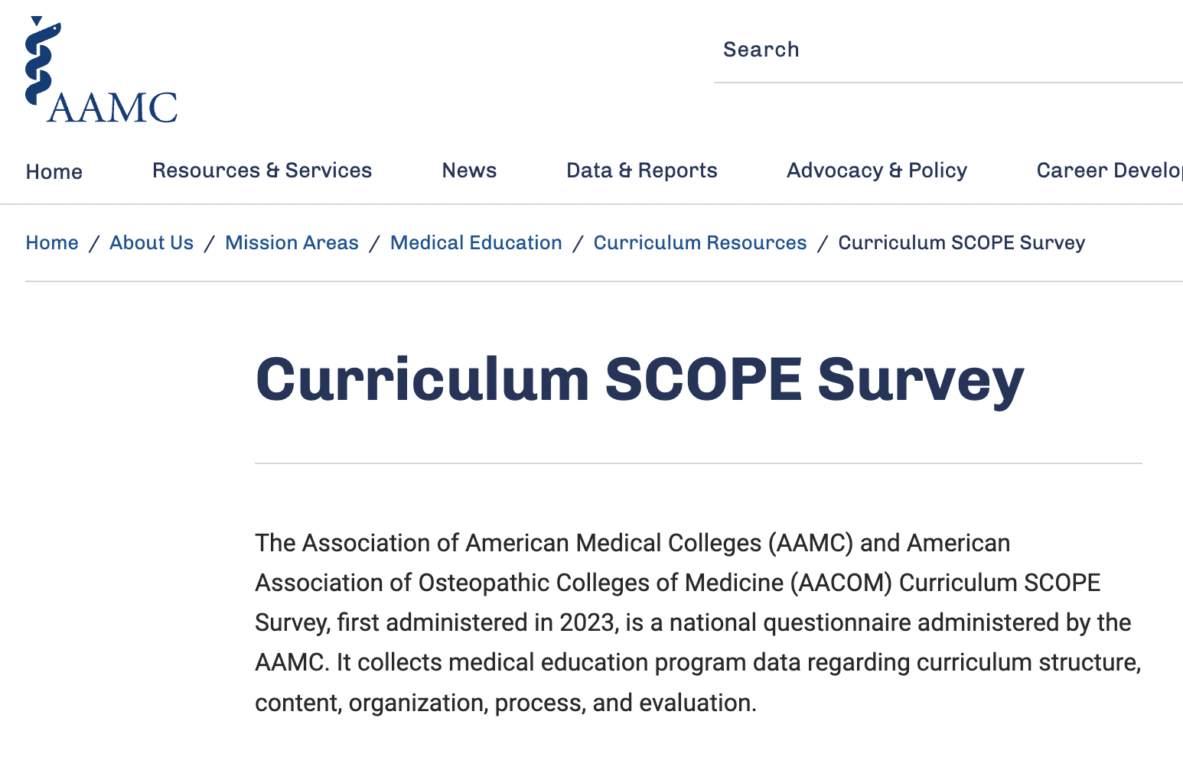
Next Steps
FSM dean completed a full curricular review for nutrition as part of its response to the AAMC-AACOM Curriculum SCOPE Survey.
36 content areas, including:
“complementary and alternative medicine” and
“nutrition” (separate from obesity /bariatric care)
Notes:
Association of American Medical Colleges (AAMC) and the American Association of Colleges of Osteopathic Medicine (AACOM)
Per the surveyors, the data collected are helpful for:
Evaluation, benchmarking, and continuous quality improvement;
Evidence-informed decision making;
Research and dissemination;
Advocacy through media, communications, and government relations; and
Guidance and evaluation of AAMC and AACOM initiatives.

Slide 56
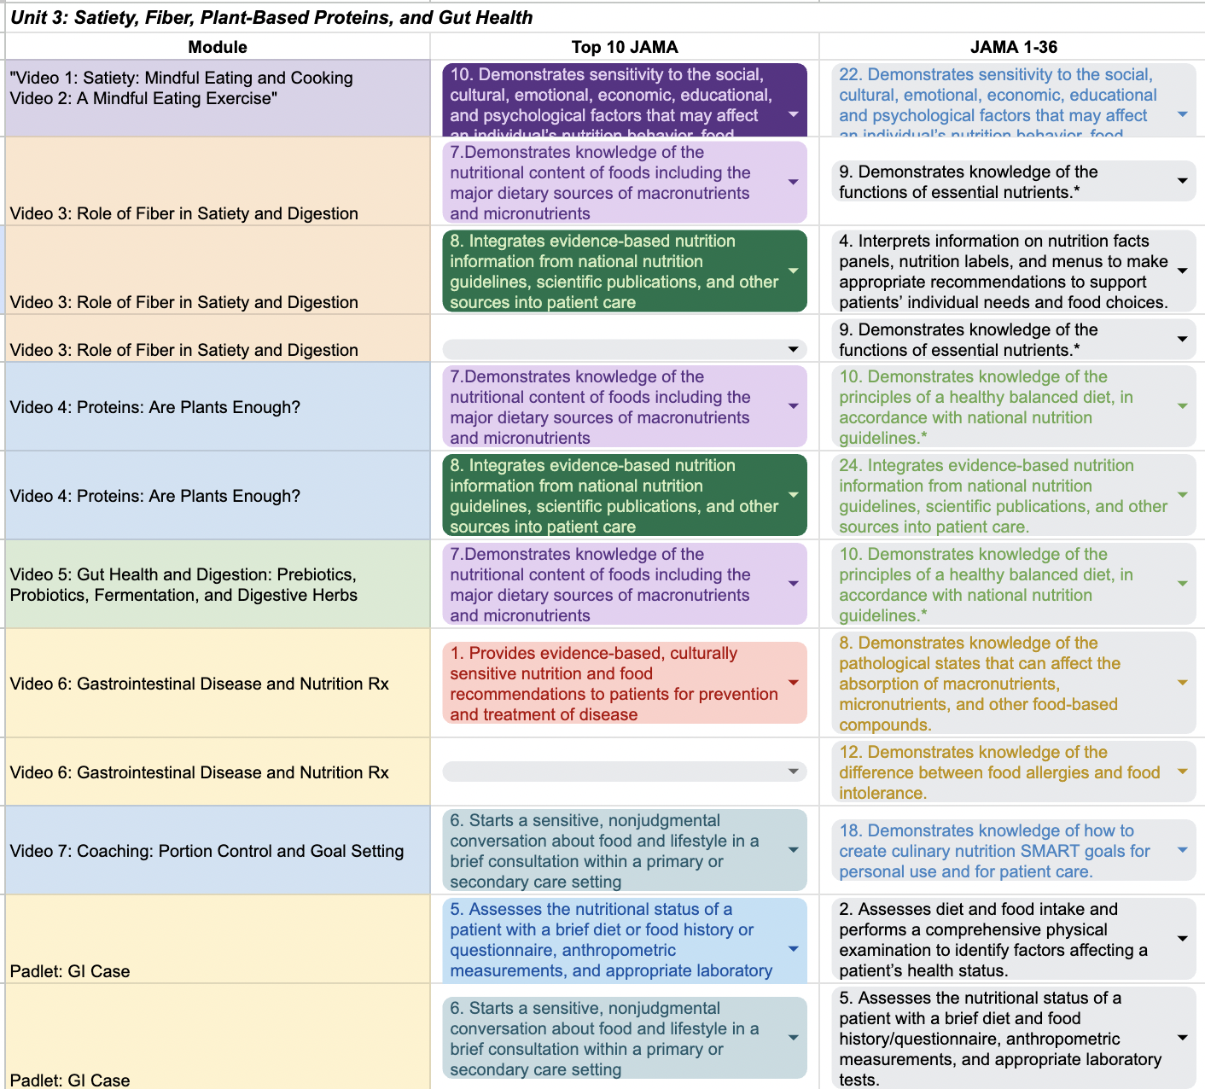
Next Steps
Competency mapping
  Current FSM nutrition content is now being compared to the 36 proposed competencies.
  Already done by Osher for Cooking Up Health (CUH) culinary medicine elective ⇨
After gaps ID’d > new content
  Eg Revamping CUH as a comprehensive off-the-shelf option

Slide 57
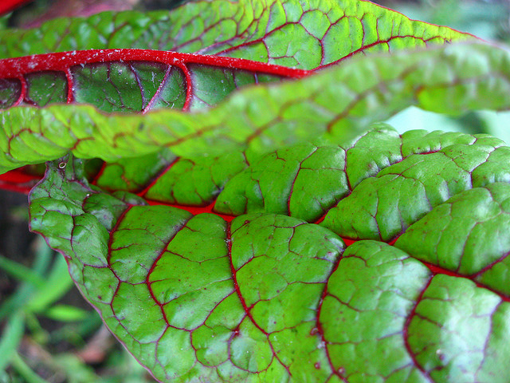
University of Utah
Culinary Medicine and Nutrition
Amy Locke, MD, FAAFP
Professor and Chief Wellness officer
Founding Course Director, Culinary Medicine
Founding Director, Health Promotion and Integrative Health Pathway
University of Utah School of Medicine

Slide 58








Culinary Medicine Growth Timeline
Start 2015
Kitchen experience with Goldring Center with SOM and COH
Seeds 2016
Water 2017
Sunlight 2018
First SOM elective offering of Culinary Medicine
UUCCN, NEW UU Culinary Medicine interprofessional curriculum Fall/Spring semesters with data collection
IPE designation, Community Engagement and capstone experiences
Seedling 2020
Sapling 2021
Tree 2022
Hybrid learning. Community events were either held outdoors or virtual. Virtual Food Is Medicine Conference
OCIH, Culinary SMA, SOM required curriculum, FIM conference, spreading the word
Course updates, skill videos, developed multiple course formats in order to pivot as needed
Fruit 2024
More faculty time, new teaching kitchens being built and planned for in clinic spaces, expansion of training and educational offerings
Notes:
Before exploring some of our Culinary Medicine programs I would like to provide a growth timeline of the past 8 years, keeping in mind that there has been an active teaching kitchen since the 1940s here at the university of Utah that has been deeply engrained in our Coordinated Masters Program training future dietitians in the Department of Nutrition and Integrative Physiology.
2015: Just like many of you inspiration came in the kitchen! A culinary medicine experience was hosted with SOM and COH administrators and faculty.
2016: Interested faculty and committed support from SOM and COH brought the Health Meets Food curriculum to UU medical students. Amy and I were the primary teaching faculty.
2017: Feeling limited by the licensed curriculum we wanted to harness the expertise and desire to provide an innovative and interprofessional learning experience to meet the unique needs of our health professional students. WE developed our own culinary medicine elective and course surveys.
2018: we received Interprofessional Education (or IPE) designation, and We also received a teaching grant to purchase mobile kitchen supplies to take cooking classes into the community, this provided valuable community engagement to meet the needs of our community members as well as provide capstone opportunities for interprofessional student teams to develop and teach hands-on cooking classes.
Then during 2020 and 2021 we adapted our curriculum to hybrid and fully virtual learning environments.
much like a sapling we needed to be nimble and flexible in order to survive.
2022: We started being able to see the light. This was a year of great growth and expansion: including the first Culinary Shared Medical Appointment Series at a community clinic, approval of the newest OCIH, hand-on cooking classes in the community, more programs of study represented in our elective, development of a1-time pilot experience imbedded in required SOM curriculum, an in-person Food is Medicine conference with interactive workshops for clinicians, and numerous media and presentations to share our work and findings.
8 years later We have more faculty joining our team, and Meded morphosis is transforming our medical school curriculum including culinary medicine experience into required curriculum, and teaching kitchens being built and planned for in clinics. Teaching Kitchens have become part of our culture here at the University of Utah, students are starting to expect these experiences, and patients are excited about this transformative care model.

Slide 59
CM Elective

Slide 60
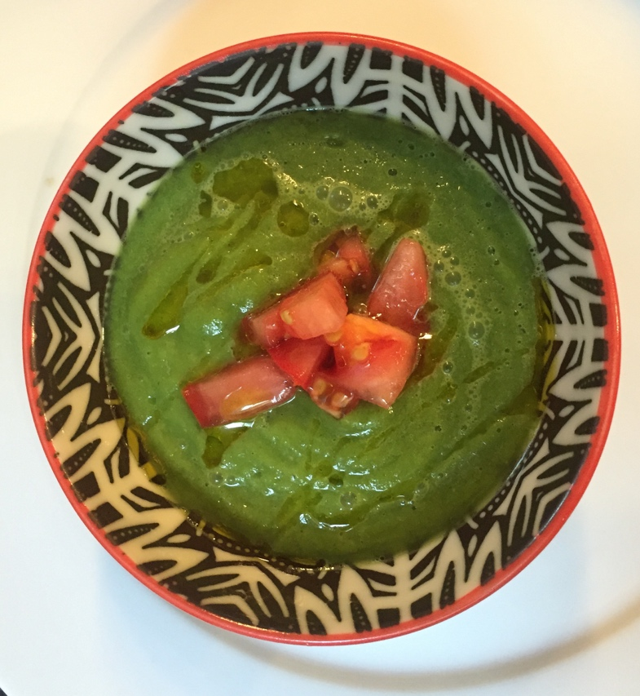
Culinary Medicine course Goals
Able to feed self and families
Incorporate as a part of self care
Create enthusiasm for healthy food
Able to explain nutrition in the context of food
Able to counsel about food and nutrition

Slide 61
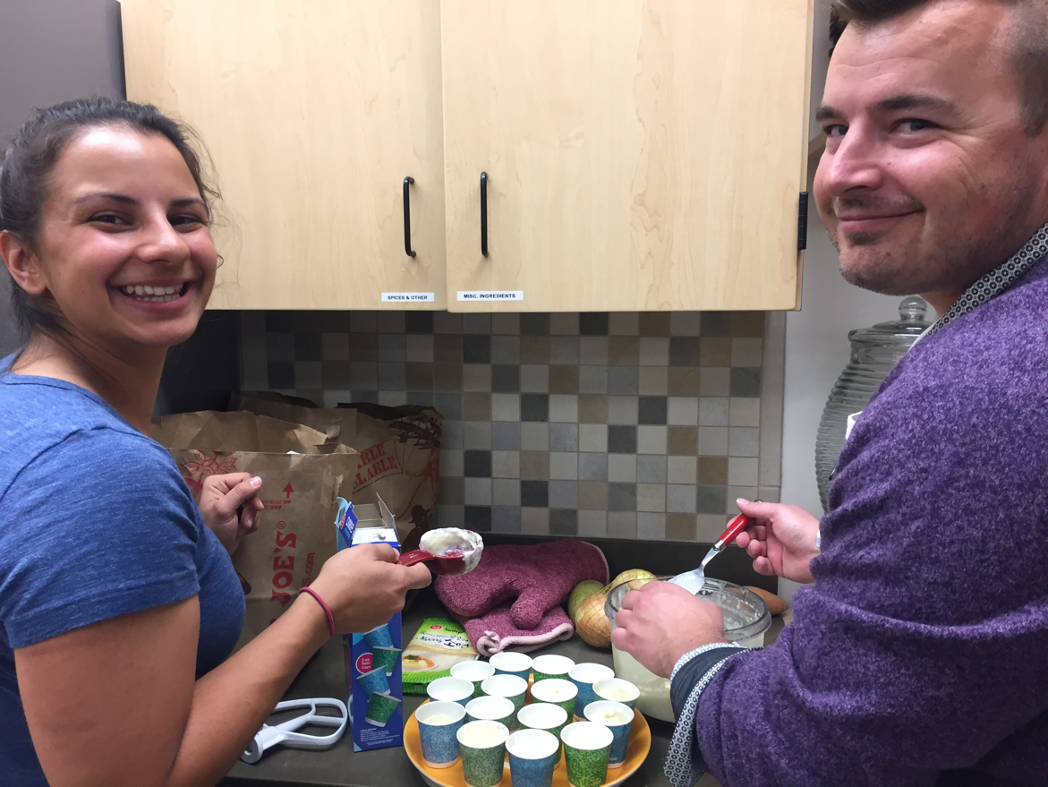
Culinary Medicine
Eight flipped classes
Interprofessional
Course directors:
  College of Health
  School of Medicine
Nutrition student as TA
Licensed curriculum to SLC VA 2019
Notes:
Guest faculty expanded idea of culinary medicine across SOM and beyond
2017/18: co-list class in College of Health and School of Medicine
COH students as volunteer; SOM and COP students participated; invited COD, CON but unable to participate
2018/19: expand to actively include students across Health Sciences
shift from Tulane to Utah: funding, content

Slide 62
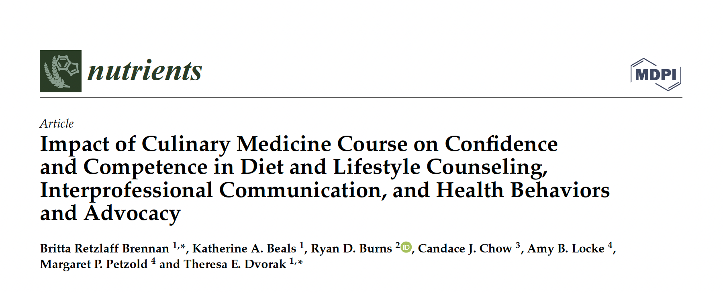
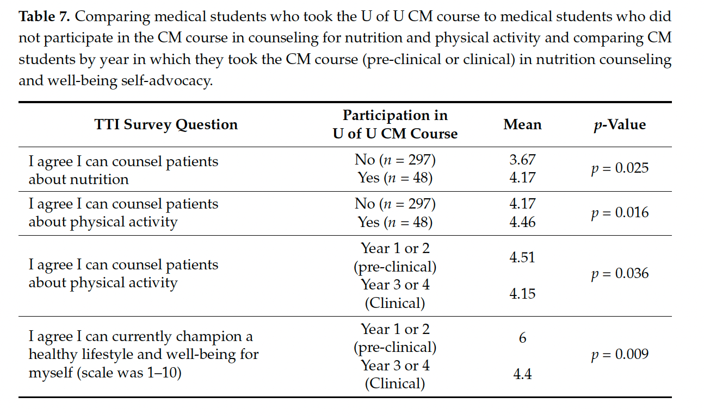
Increased self confidence in counseling on nutrition and lifestyle medicine over course
At SOM exit, stronger confidence than students who did not take elective

Slide 63
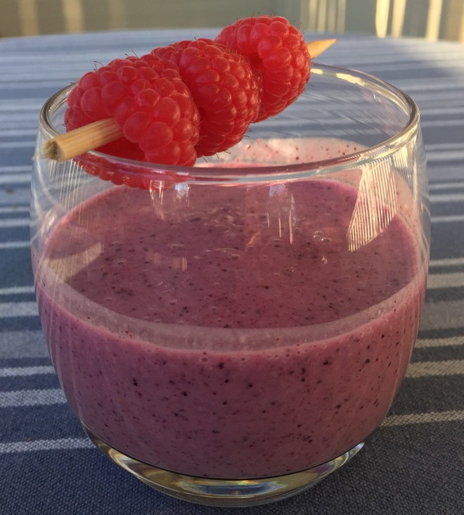
Nutrition Partnership
Department of Nutrition and Integrative Physiology
  Donated space and faculty time
  ‘We can’t do it alone’ mentality
  High value in interdisciplinary learning and practice
    Improved outcomes and lower medical costs with interdisciplinary care ^{1,2}
    Exposure to interdisciplinary environments in the learning/training of clinicians
1. Montesi et al. DM Met Synd Obes 2016; 2. Wolf et al. J Am Diet Assoc 2007
Notes:
Involvement priority: Donated space and faculty time
We can offer better patient centered care by working together
Share TA with community classes
The Look AHEAD Research Group. Eight- year weight losses with an Intensive Lifestyle Intervention: The Look AHEAD study. Obesity. 2014;22(1): 5-13.
Montesi L, El Ghoch M, Brodosi L, Calugi S, Marchesini G, Dalle Grave R. Long-term weight loss maintenance for obesity: a multidisciplinary approach. Diabetes Metab Syndr Obes. 2016;9:37-46.
Wolf AM, Siadaty M, Yaeger B, Conaway MR, Crowther JQ, Nadler JL, Bovbjerg VE. Effects of lifestyle intervention on health care costs: Improving Control with Activity and Nutrition (ICAN). J Am Diet Assoc. 2007;107(8):1365-73.

Slide 64
Registered Dietitian as Co-director
  Practical experience with diverse clients/ diagnoses
  RDN’s with knowledge and skill in food management (Food Handler’s permit)
  Expertise in running a student/teaching kitchen
  Space suitable for hands-on learning
  Coordinated Masters Program- Future RD’s
Notes:
Practical experience: evidence based practice as well as practical experience increases one’s ability to more effectively troubleshoot and help client/patient to come up with solutions. Helps students see practice is not always black and white we are working with humans there is a lot of gray space!
Food Management: organization of a kitchen and supplies, recipe knowledge and substitutions, food safety/ handling comply with health department
Experience running cooking classes learners of all ages pediatrics/ adolescents/ university and adult learners…Organization and keeping the Foods Lab running on schedule, nose to the air…
Foods Lab: 6 cooking stations
CMP: experience working interdisciplinary; medical student exposure to dietetic professionals, better understanding of each others areas of expertise and how to work together

Slide 65
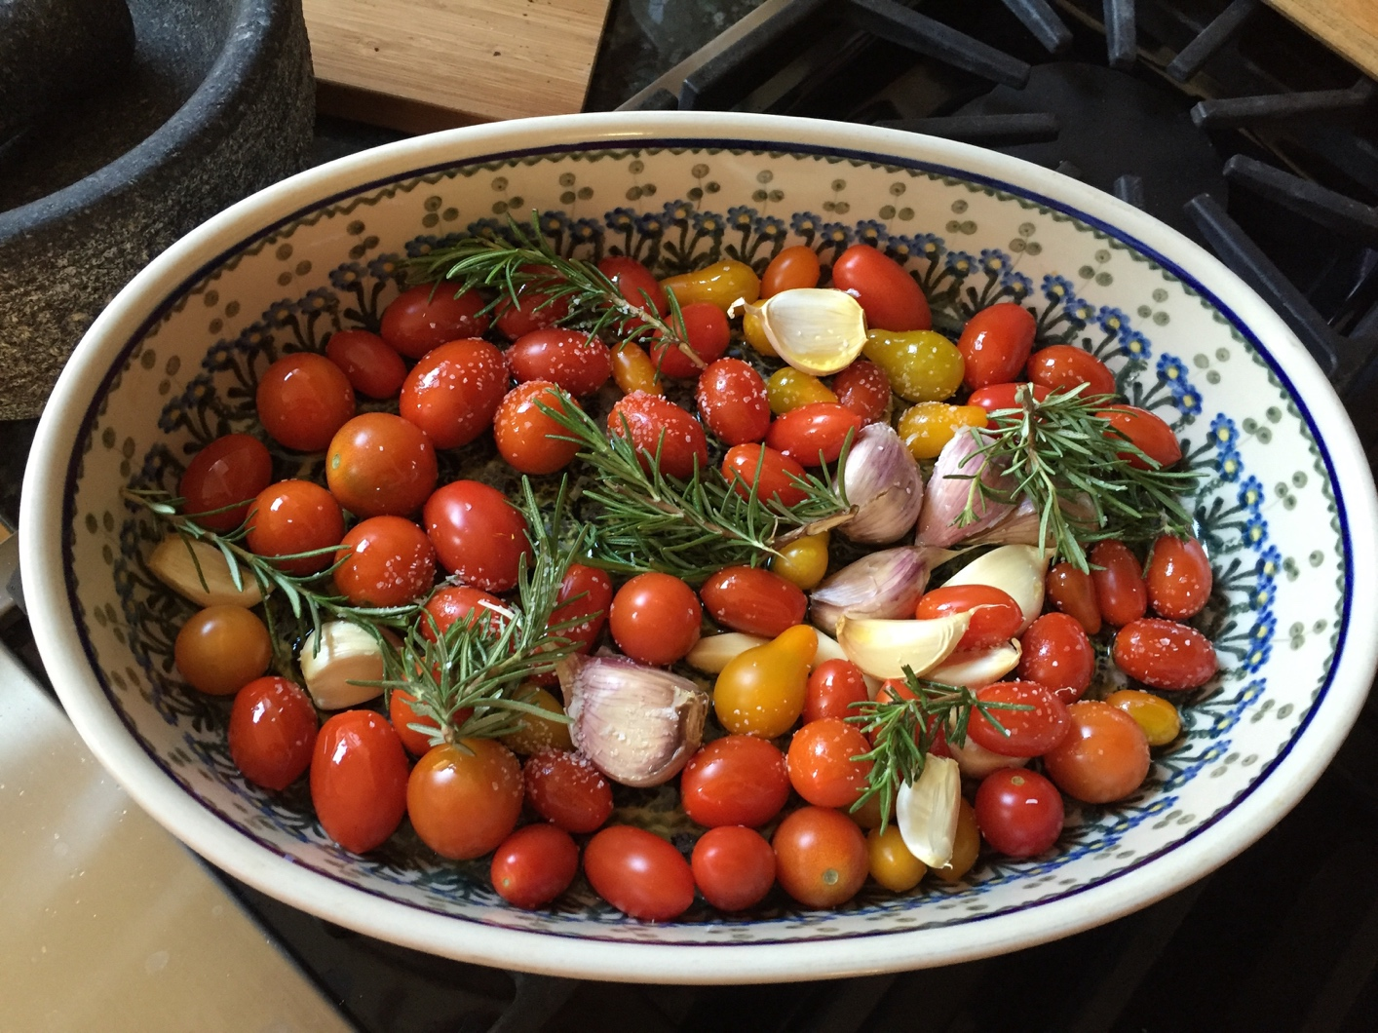
Potential Roadblocks
IPE logistics
  Timing
  Paying faculty
  Cross listing vs. IPE class
FUNDING
Notes:
Scope of practice tensions have come up at other institutions

Slide 66
”I was introduced to many different flavors and food experiences and it has completely changed how I stock my fridge. Most importantly, I have learned how to incorporate delicious vegetables into most of my meals. This class has boosted my confidence in the kitchen and I have tackled difficult recipes at home now that I understand the vocabulary. Before, it was difficult for me to even identify fresh garlic at the grocery store.”
Culinary Medicine Student

Slide 67
“Cases are really thought provoking. I’ve already changed my approach to patients.”
Culinary Medicine Student

Slide 68
Survey Questions |  | Mean
 | SD | Pre- ** | Post- ** | p-Value
Interprofessional Environment
How valuable is the inter-disciplinary nature of this class (students potentially from colleges of health, nursing, pharmacy, and school of medicine): | +/−0.77 | 4.59 | 4.40 | 0.07
Students will be able to effectively communicate with other professionals in an interdisciplinary manner. | +/−0.89 | 3.72 | 4.48 | <0.001
Health Behaviors and Advocacy
Students will be able to identify their own areas for future growth in the area of nutrition and food preparation. | +/−0.87 | 3.59 | 4.49 | <0.001
Champion a healthy lifestyle and well-being for myself. | +/−0.81 | 3.80 | 4.15 | 0.005
Champion a healthy lifestyle and well-being for a community. | +/−0.82 | 3.46 | 4.29 | <0.001
Students will be able to prepare eight healthy meals. | +/−1.09 | 3.58 | 4.57 | <0.001
How many cups of vegetables do you eat, on average, each day? * | +/−1.20 | 2.24 | 2.69 | 0.09
How many days of the week, on average, did you get at least 30 min of moderate physical activity? * | +/−1.91 | 3.80 | 4.13 | 0.29
How much sleep do you get on an average night? * | +/−1.08 | 6.92 | 7.10 | 0.35
How many meals did you eat out (i.e., restaurant, cafeteria, store, vending machine, etc.)? * | +/−3.17 | 6.37 | 5.55 | 0.10
Notes:
We found that students improved their ability to communicate interprofessionally
Students were able to Identify and Improve their personal health behaviors in areas of nutrition and food preparation. They also identified significant improvements in championing a healthy lifestyle and well being for themselves and their community.
With the data we collected during the semesters affected by Covid, We found that there was no difference in the educational environment, so no matter if the student was in-person, hybrid, or fully virtual the findings were the same.
No significant differences were observed between the in-person or the mixed-mode cooking groups (p > 0.05)

Slide 69
Health Promotion Integrative Health Pathway of Excellence

Slide 70
The Vision
Physicians able to champion healthy lifestyle, preventive medicine and wellness at the level of themselves, their individual patients, and their community.
Notes:
Move beyond the impulse to focus on pharmaceuticals and procedural interventions.
You are going to learn A LOT about medications and procedures and that is great, but we also want you to learn how to use lifestyle and other modalities to prevent and treat illness.
Chronic illness is dramatically impacted by a person’s lifestyle and health behaviors, yet medical care focuses primarily on the medical interventions of pharmaceutical and procedural approaches. In this track, students will go beyond the background biochemical science to see how it applies to the real world of food choice, physical activity, sleep, stress management and connection with the world around them.
What is unique about this curriculum is the attempt to improve the wellbeing of the student as well as future patients.

Slide 71
Utah Pathways Process
Form Groups
Identify Content
Complete Initial Proposal Doc
Develop Content Depth
Curricular Integration Plan
Recruit Core Faculty
Develop MS1 Curriculum
Develop Pilots for MS2-MS4
Recruit Core Faculty & Students
July
Dec
Apr
Aug
MS4 Pilot
MS4 Pilot
MS4 Pilot
MS4 Operation
MS3 Pilot
MS3 Pilot
MS3 Operation
MS3 Operation
MS2 Pilot
MS2 Operation
MS2 Operation
MS2 Operation
MS1 Operation
MS1 Operation
MS1 Operation
MS1 Operation
2017 – 2018
2018 – 2019
2019 – 2020
2020 - 2021

Slide 72
Health Promotion and Integrative Health
Lifestyle Medicine
Resilience in Medicine
Whole Person Health
Working in Teams
Healthy Communities
https://medicine.utah.edu/programs/md/curriculum/pathways
Notes:
On the surface you may see a lot of overlap between the other Pathways you’ll hear about today, especially Population Health. Let me tell you a bit about the differences.
This is what the pathway looks like: we help students understand what it takes to be healthy by looking at the foundations of health (lifestyle medicine).We take a deep dive into the science of nutrition, physical activity, sleep and stress. We look at what it takes to stay healthy in a career in medicine. This is applying those foundations to work in healthcare. We look at how the whole person fits together in the context of their family and community. How does their mood fit with their diabetes, with their pain, with their family relationships and their community. We teach students how to work in teams to provide optimal patient care. We help students understand what they can do to help the health of their communities.

Slide 73
4-year Overview
 | Fall | Spring
MS1 | Foundations of Health FPMD 7810 | Principles of Integrative Medicine FPMD 7811 Independent projects (through Summer)
MS2 | Resilience in Health Care FPMD 7812 | Health Behavior Change in Patients and Communities FPMD 7813
MS3 | Clinical Applications of Health Promotion and Integrative Health FPMD 7814
MS4 | Electives | Capstone Presentation
Notes:
Each of these core classes is 0.5 credits each
Mentors assigned in fall of MS2 year to help shape experiences
There are a couple of experiences in MS1 year that complement this curriculum: Wellness lecture on nutrition on Fall Semester and Introduction to IM in Layers of Medicine Winter Semester. Recommend taking Culinary Medicine Spring MS1 year, Fall MS2 year, or during MS4 year.
Capstone: Research, Community outreach, Education

Slide 74
SAMPLE OF STUDENT PRESENTATIONS AND PROJECTS
Food for Your Mood | Alzheimer’s Disease and Potential Therapies | Music Therapy | Narrative Medicine | Into to Strength Training
Mindfulness | Sleep and Memory | Breath | Nature and the Hospital Environment | Environmental toxins
Health Benefits of Meditative Practice | Gratitude and Wellness | Gut Health | Acupuncture in Oncology | Relative Energy Deficiency
Intermittent Fasting | Creative Aging | Yoga | Meditation | Gardening/green space and health
Animal Assisted Therapy | Circle of Life | Sleep | Adaptive Sport and Exercise | Value of Nature on Health
Culinary Medicine | Books and Wellness | EMDR | Forrest Bathing | Nutrition in Spine Surgery
Notes:
Examples of topics HPIH students have presented, inspired by the pathway.

Slide 75
Semester 1: Foundations of Health
Introduction to the Science of Lifestyle and Health Promotion
Sleep: Science and Clinical Applications
Physical Activity Prescription
Mindfulness
Shadowing experience
Notes:
Shadowing experience is based on student’s interest.

Slide 76
Semester 2: Principles of Integrative Medicine
Introduction to Integrative Medicine
Label Reading and Giving Advice
Manual Medicine
Collaborative Teams
Shadowing experience

Slide 77
Semester 3: Resilience in Health Care
Principles of Resilience and Creating a Self-care Plan
Resilience Skills for Physicians
Building Health in Healthcare: a System Approach
Recognizing Risk in Others

Slide 78
Semester 4: Health Behavior Change in Patients and Communities
Community outreach: programs, engagement and talking with patients
Motivational Interviewing and Appreciative Inquiry
Student topic presentations
Student topic presentations

Slide 79
Semester 5/6: Clinical Applications of Health Promotion and Integrative Health
Personal Wellness
Lifestyle and Integrative History
Comprehensive Plan
Wellness of Teams
Notes:
Quarterly dinner to touch base and regroup
Question of session to guide conversation
Quarterly case/discussion posted to Canvas
Use case from current rotation to highlight relevance of experiences

Slide 80

Electives
Culinary Medicine
Integrative Medicine
Manual Medicine
Mindfulness
Lifestyle Medicine
Notes:
Bold ones approved by curriculum committee already.
Might include some of these. Up to individual.
Can be in any of the four domains.
What electives currently exist and should be included?

Slide 81
“I feel like pathway is presenting me with knowledge that will make me a better doctor, and that also has improved my life.”
Health Promotion Integrative Health Student

Slide 82
REQUIRED EXPERIENCES

Slide 83
Next Steps
2022: CM lab for all first year students
2024: All third years received core sessions on nutrition, physical activity, mindfulness and sleep.
2025: HPIH pathway has been invited to propose how entire curriculum could be incorporated for all medical students
Notes:
1x CM Experience
Required curriculum in SOM
1-hour didactic pre-work
3 hour hands-on cooking class
Reflection assignment

Slide 84
First Year Medical Students
I went outside of my comfort zone and ate mushrooms (I hate mushrooms so much), and they were GOOD!
Even though I am still not an expert, this made it seem possible to gain the experience that I need to give my patients guidance about how to eat. I now feel like I could one day encourage my patients and ensure them that meal planning and eating well is not as complicated as they might think.
Today I learned that the delicious and healthy food we made was only $6 per person. So, I now feel confident that healthy food options are not always expensive.
As a busy student it was great to see firsthand how quickly a healthy meal can be prepared with little to no cooking experience. This makes me a lot more willing to consider having healthy recipes on hand for both me and my future patients.
The most useful part of this experience was being able to see tangible ways to achieve nutritional goals. I have learned about the importance of a healthy diet but to actually be shown how a healthy diet can be attainable and the exact steps I need to take to achieve it is useful.
Notes:
1x CM Experience
Required curriculum in SOM
1-hour didactic pre-work
3 hour hands-on cooking class
Reflection assignment

Slide 85
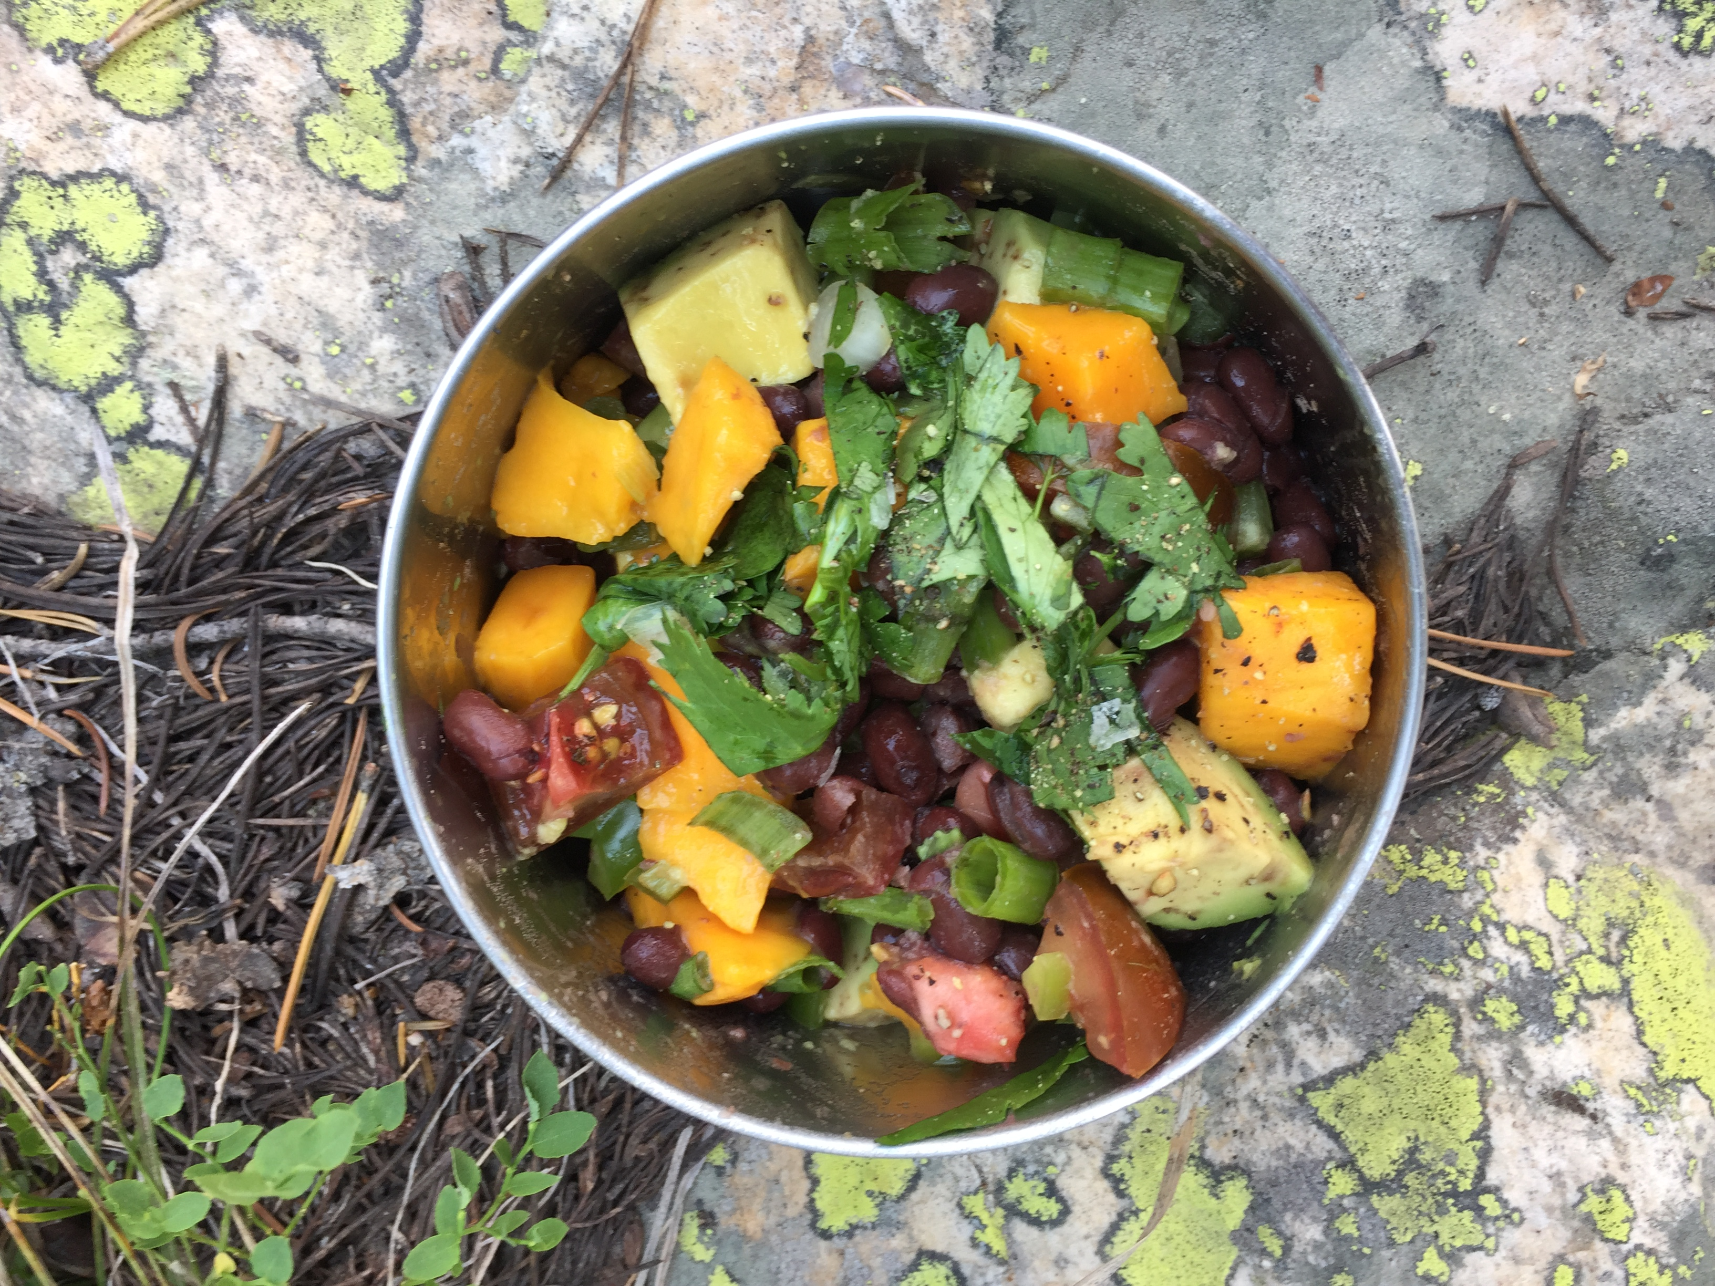
Questions?

